Slide 1
Real Estate: Design to Development
Groups
Group #1 - Ryan, Jess, Grace
Group #2 - Matt, Robert, Sean, Emre
Group#3 - Alice, Maggie
Group #4 - Jeremy, Myles, Dennis
Group #5 - Dennis, Jacob was also present

Slide 2
All around the world!
Ryan- New Orleans, Louisiana
Grace- Lexington, Kentucky
Jess- Wyckoff, New Jersey
Alice- Hong Kong, China
Dennis- Athens, Greece
Maggie- Macau, China
Sean- Singapore
Theo- New York, New York
Myles- Atlanta, Georgia
Jacob- Los Angeles, California
Dennis- Washington D.C.
Emre- Istanbul, Turkey
Jeremy- Los Angeles, California
Oliver- New York, New York
Robert- Upper Saddle River, New Jersey
Matt- Palm Beach, Florida

Slide 3
Our Goals for this Class
To achieve a general understanding of real estate
To understand the processes and people that are involved in a real estate development
To learn the functions of developed properties and the tenants that occupy them

Slide 4
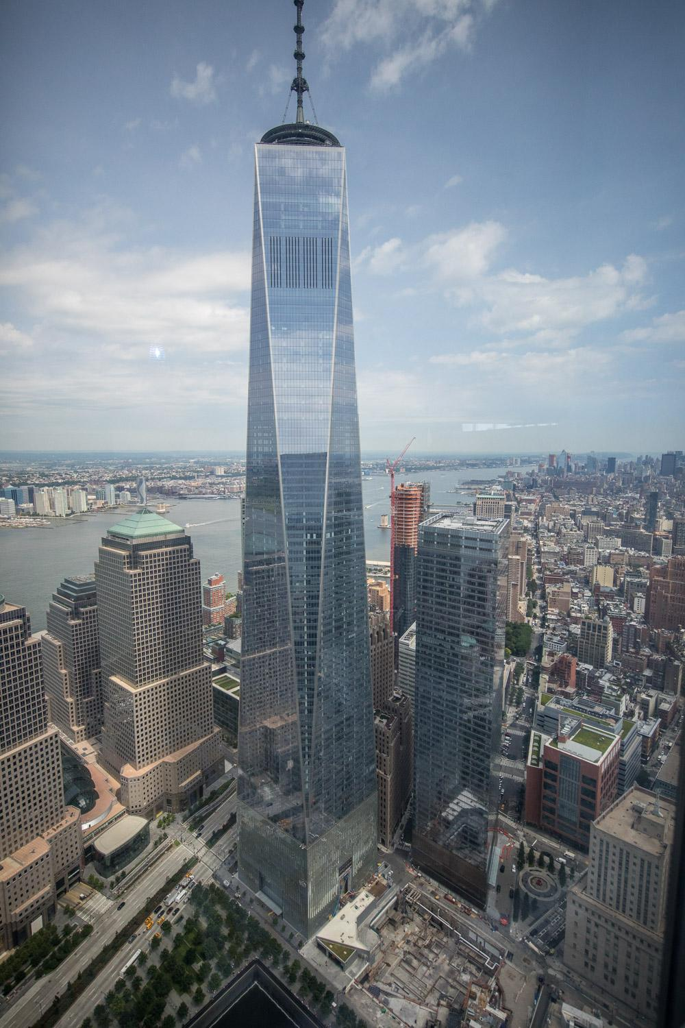
What We Did
Lectures about all aspects of real estate development
Developers of the property on 13th Street and University Place gave us a lecture about their project
Lots of Field Trips
Learned how to find a property and vision an idea to build a development

Slide 5
Our Field Trips

Slide 6
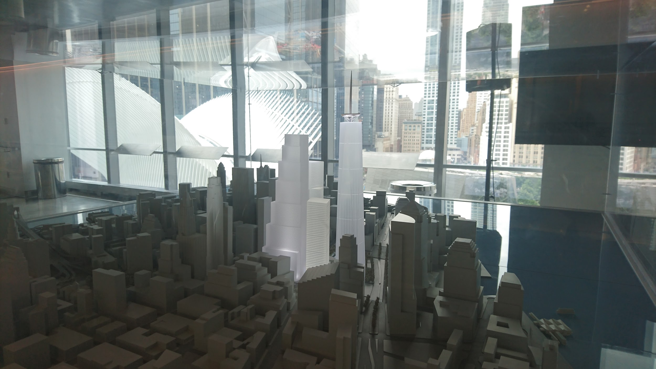
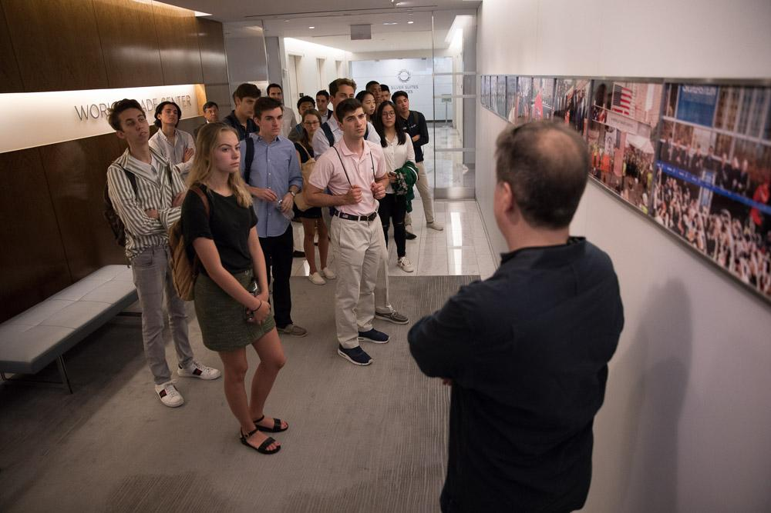
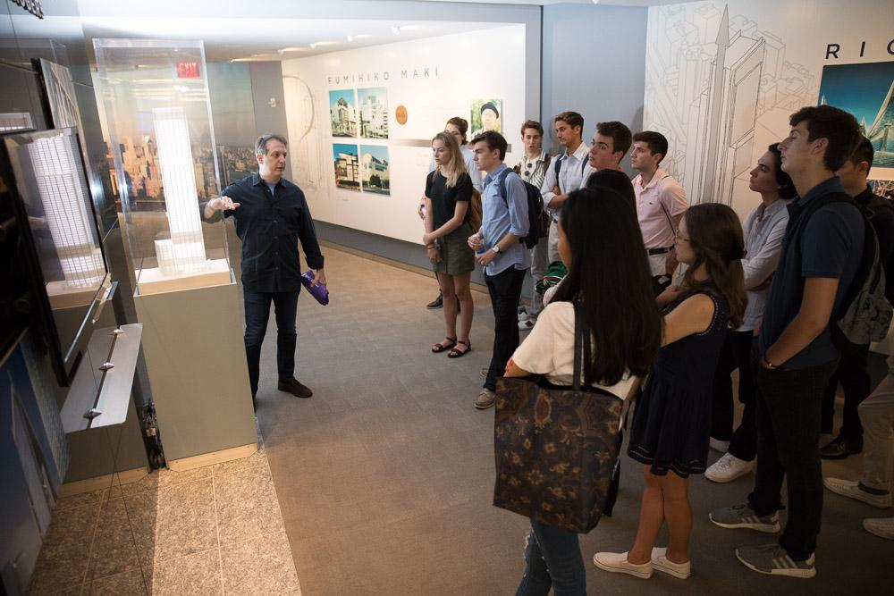
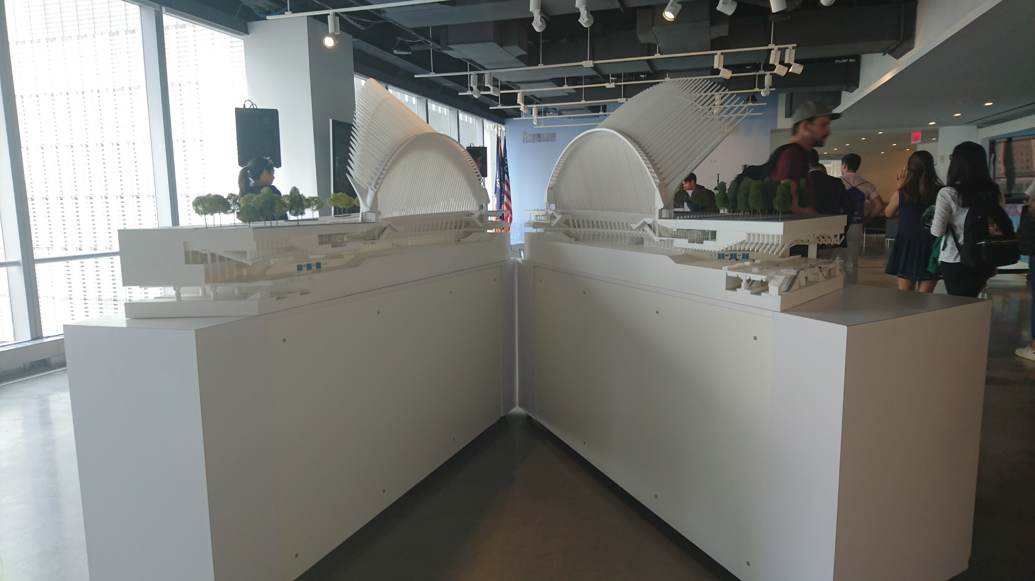
Silverstein Properties

Slide 7
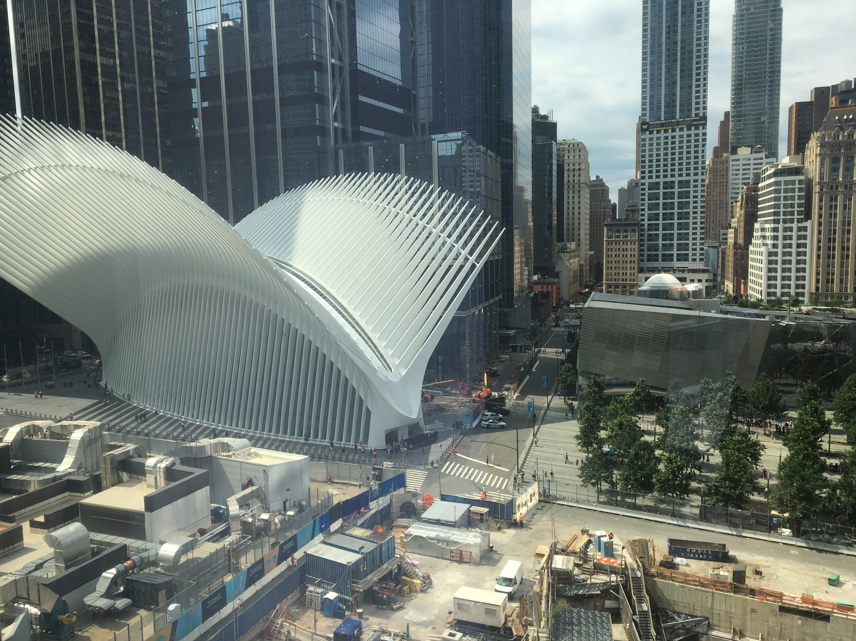
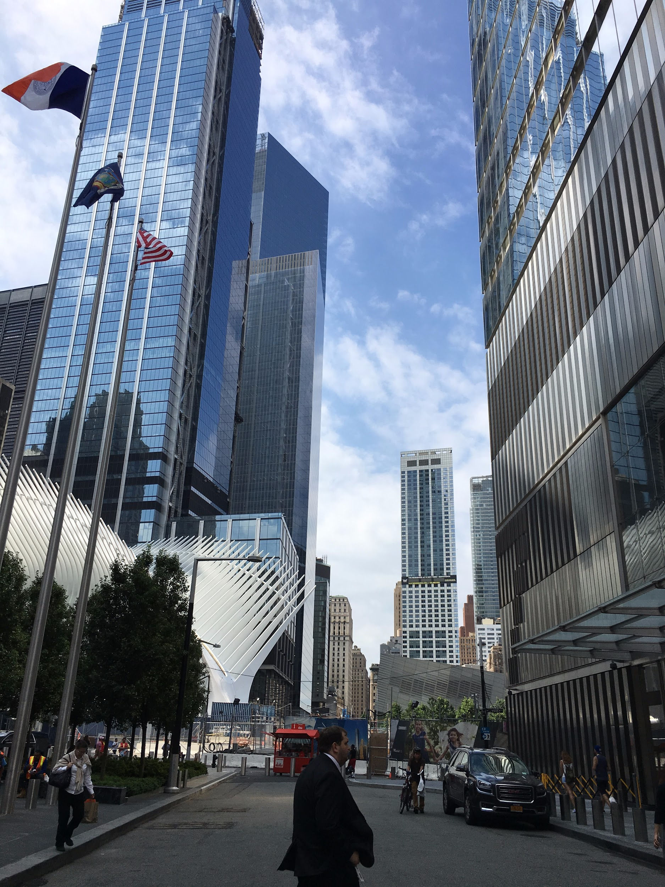
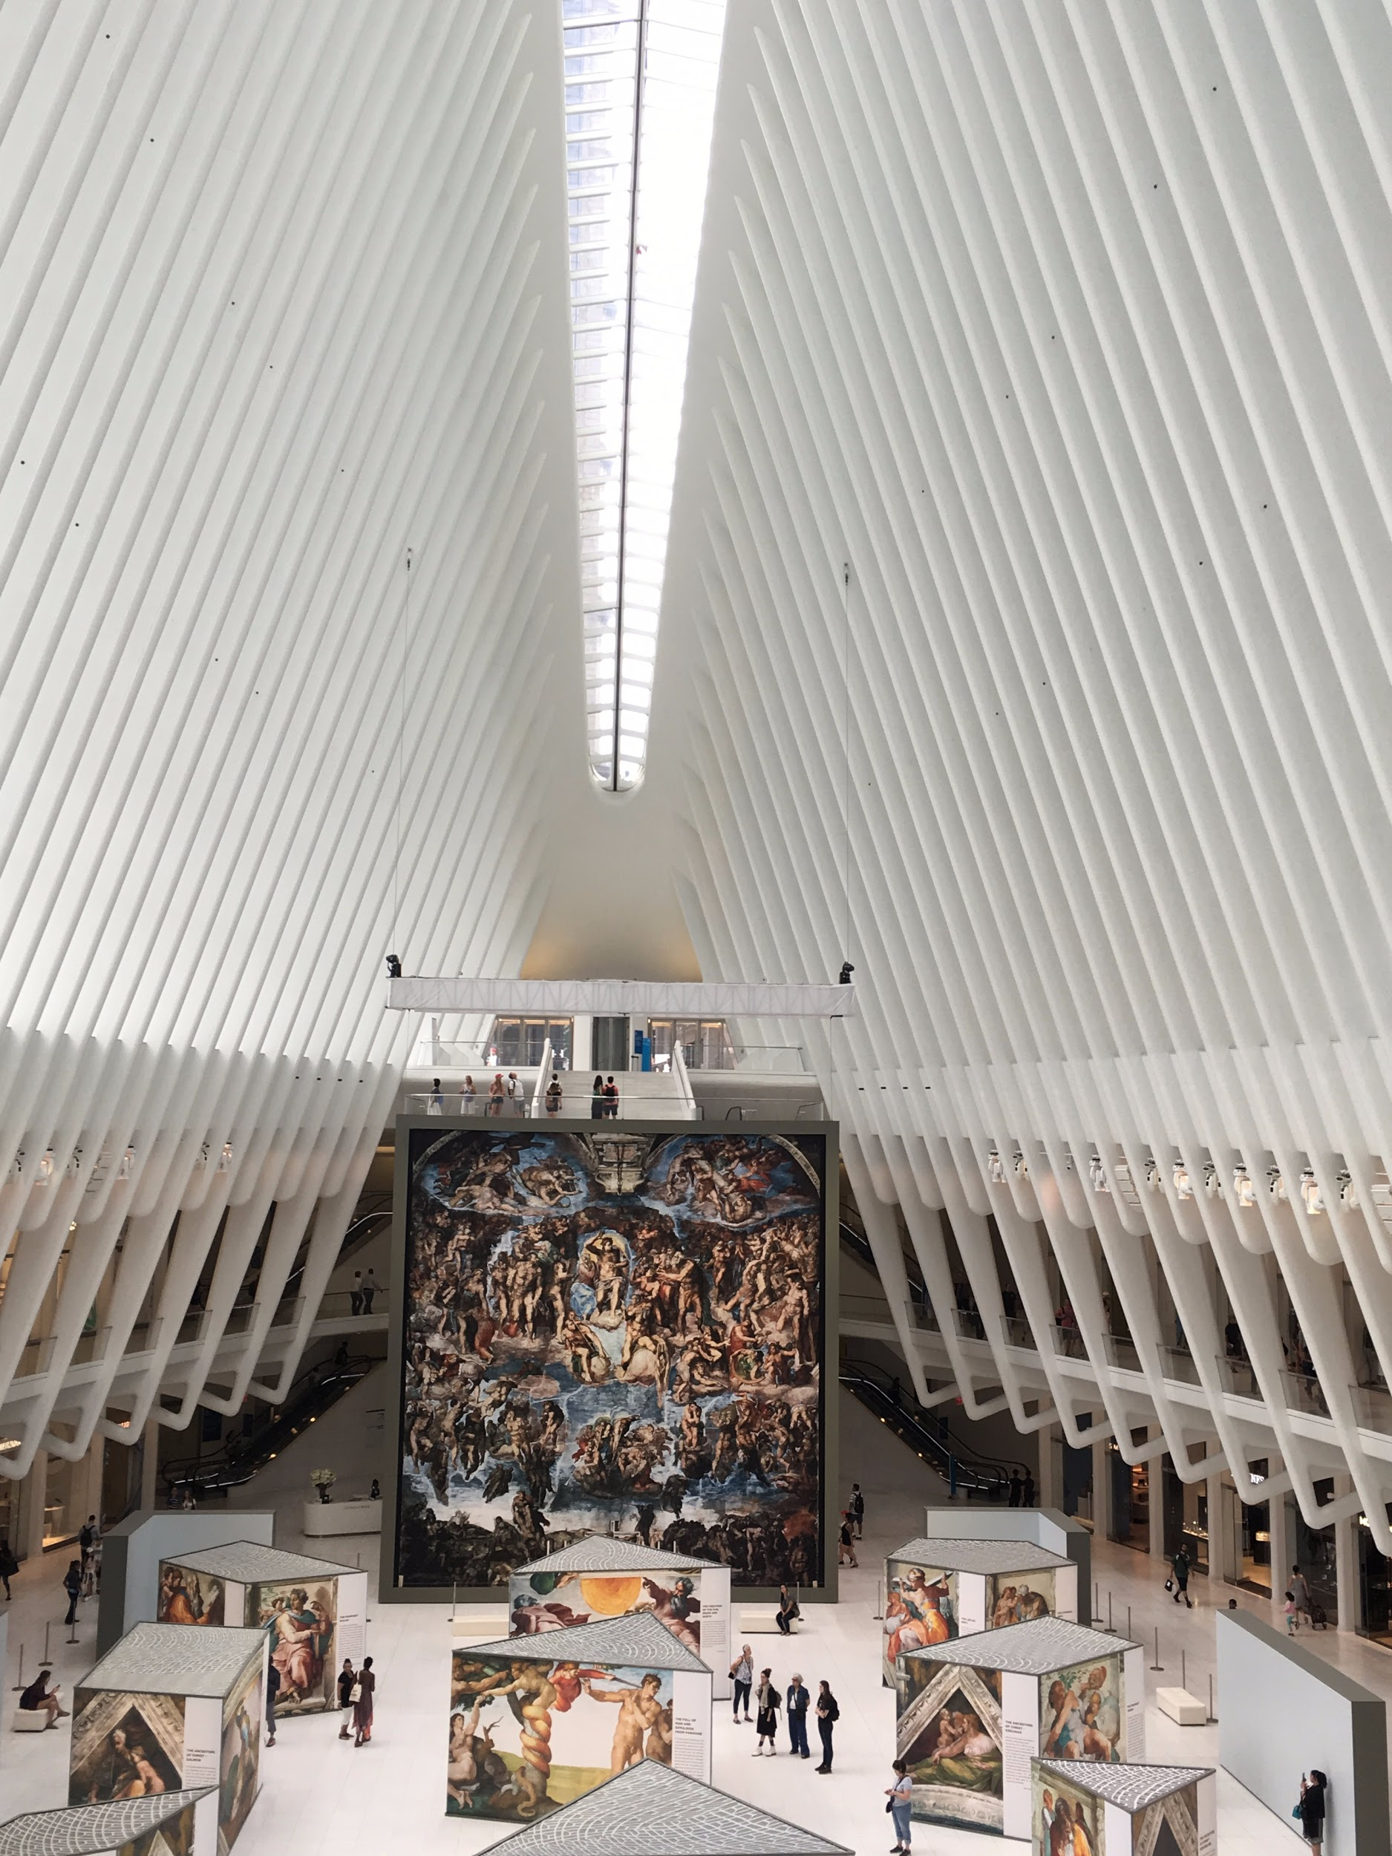
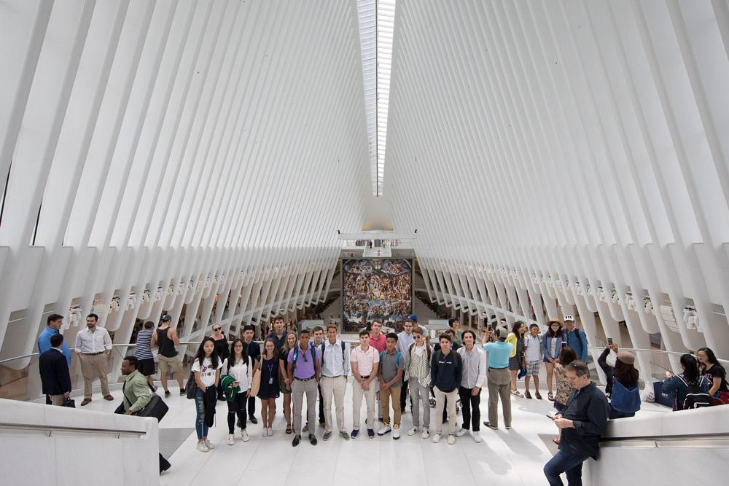
Oculus

Slide 8
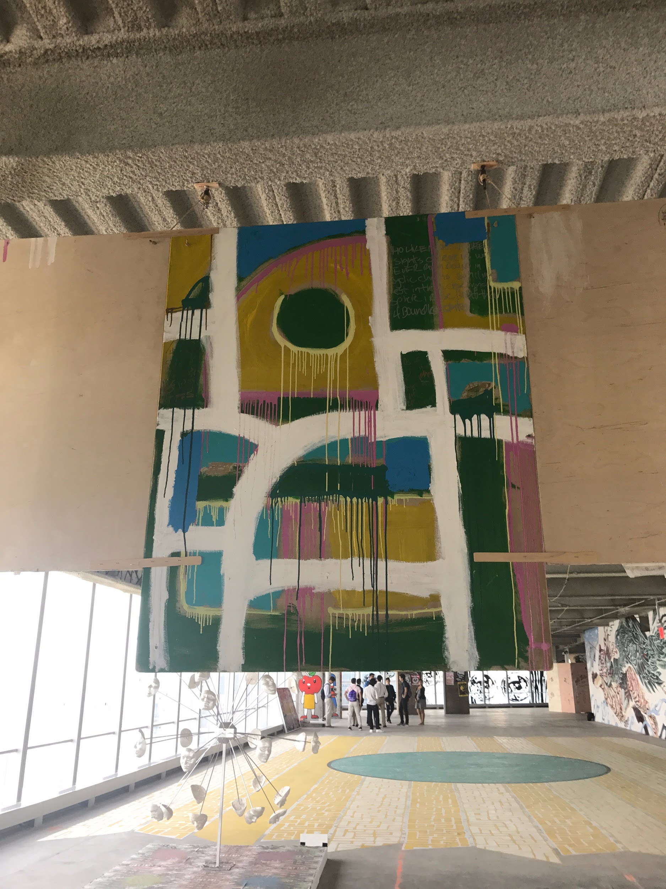
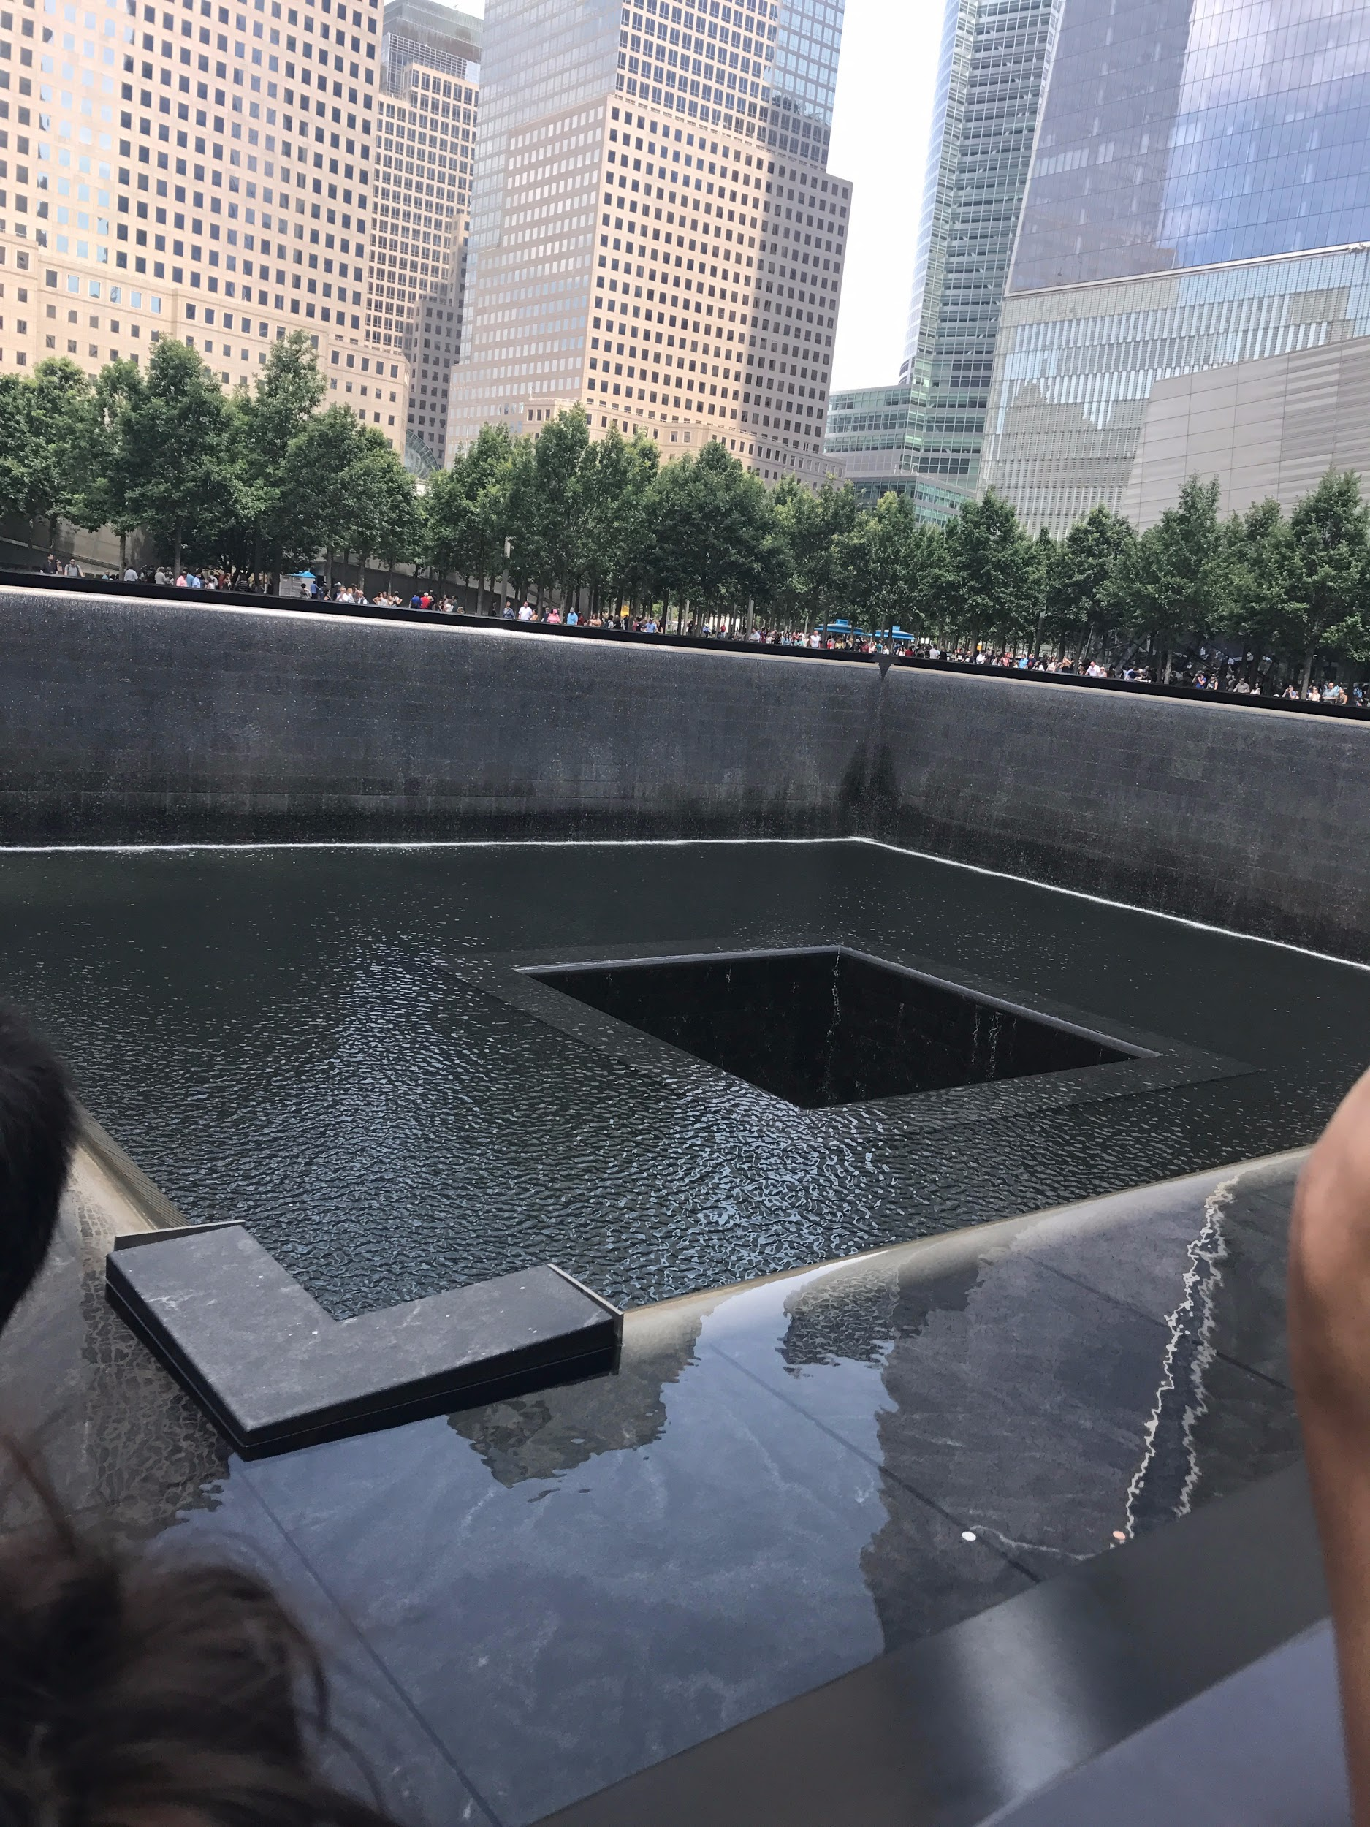
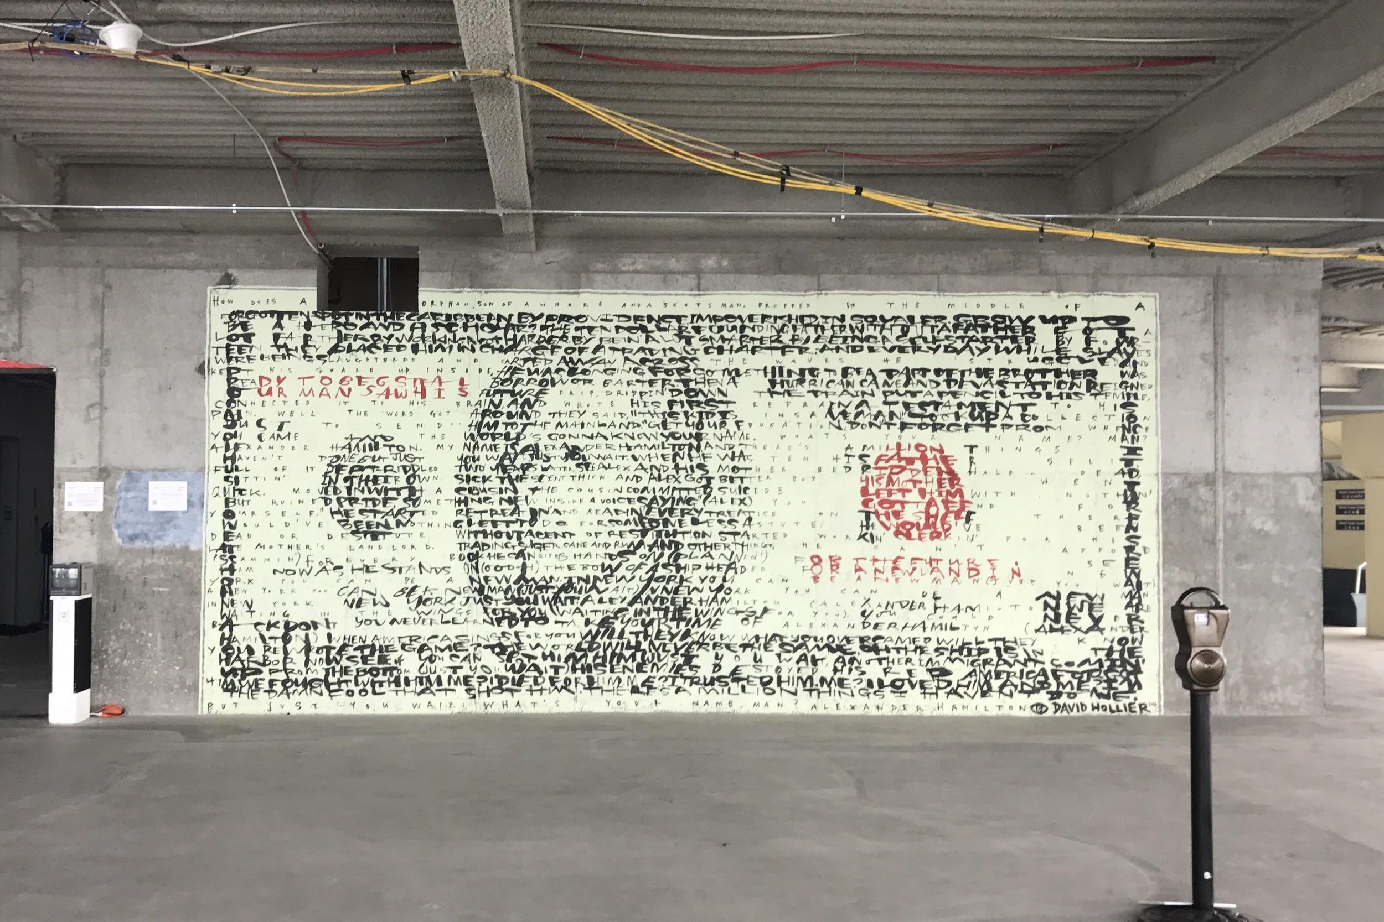
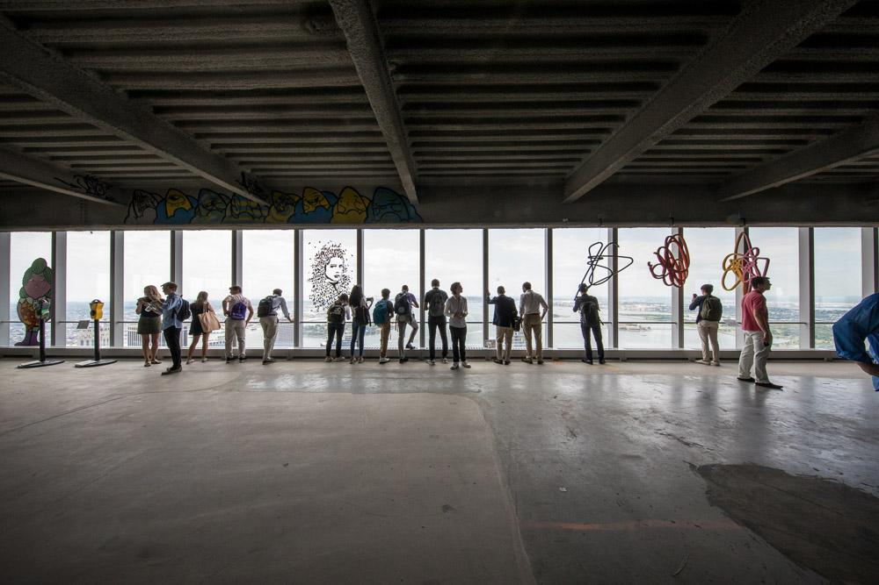
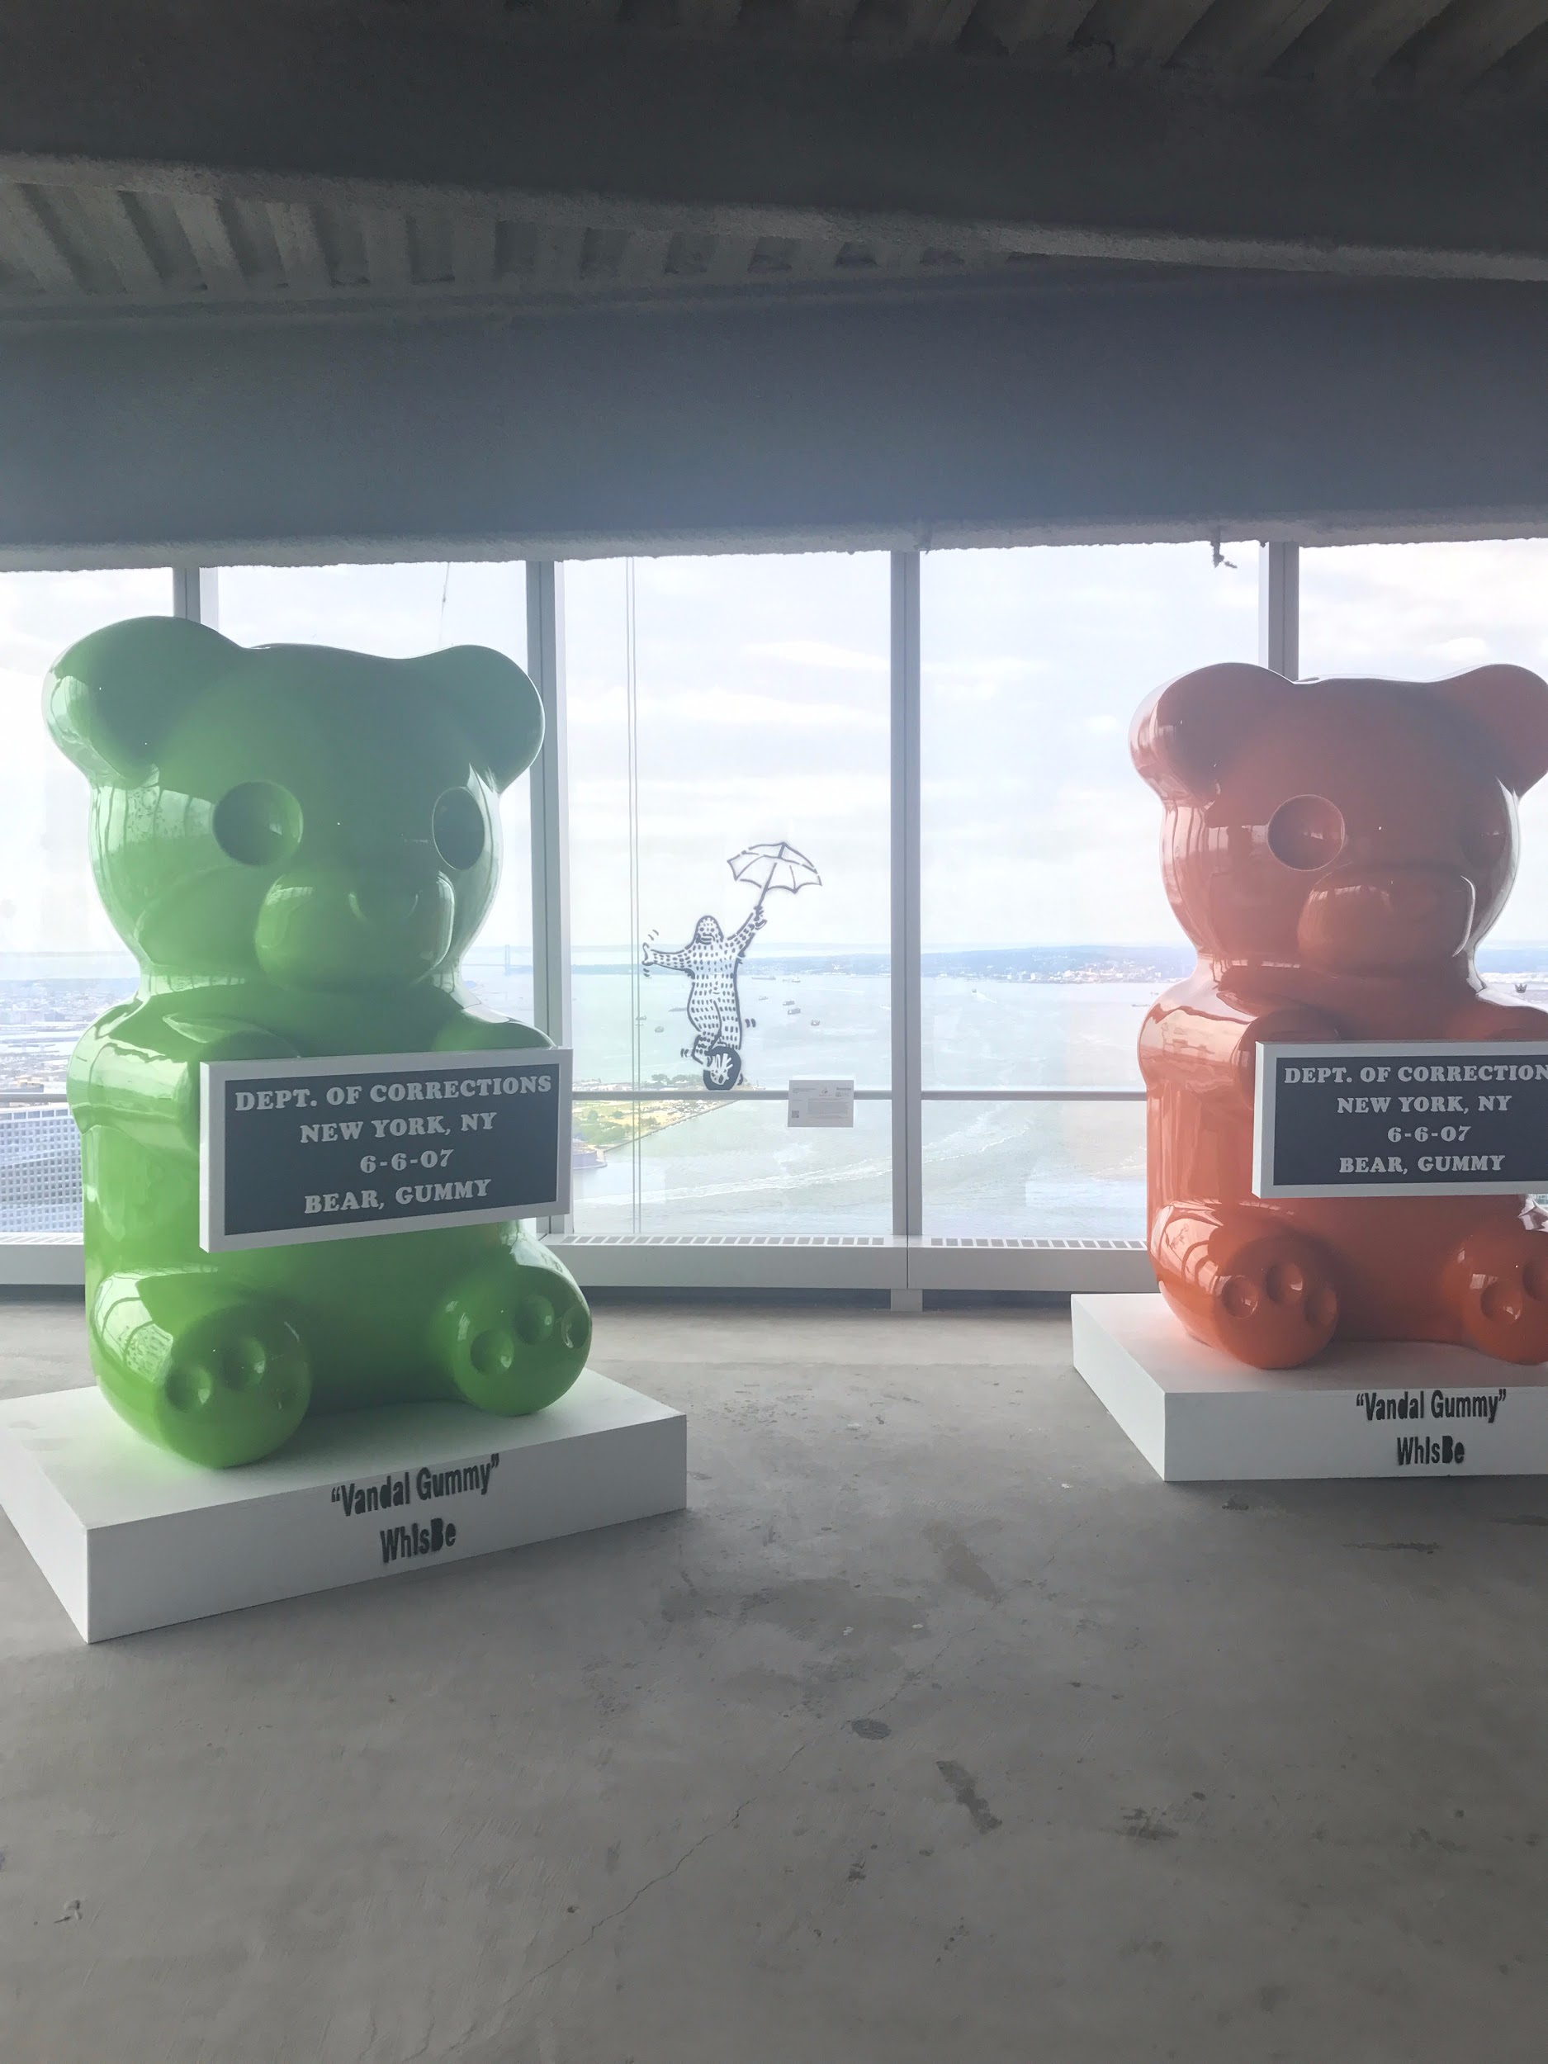
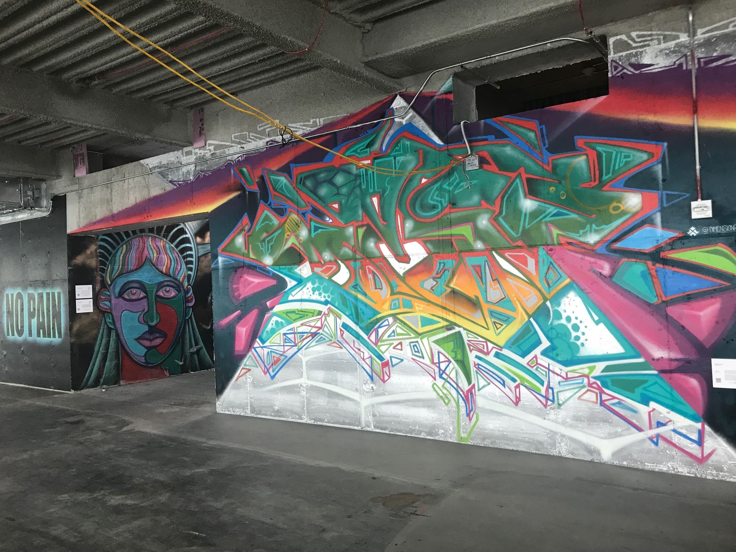
4 World Trade Center

Slide 9
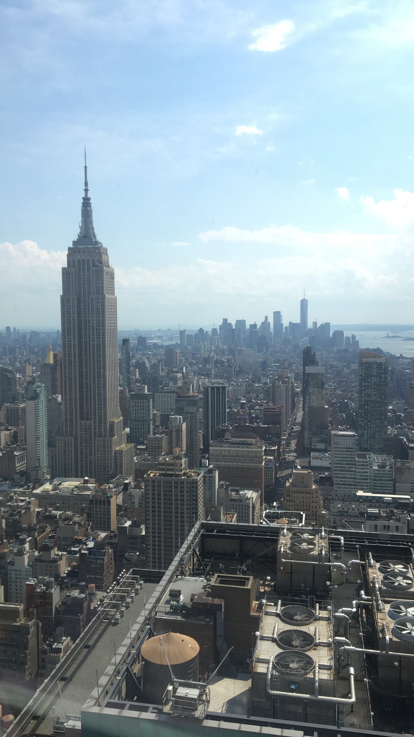
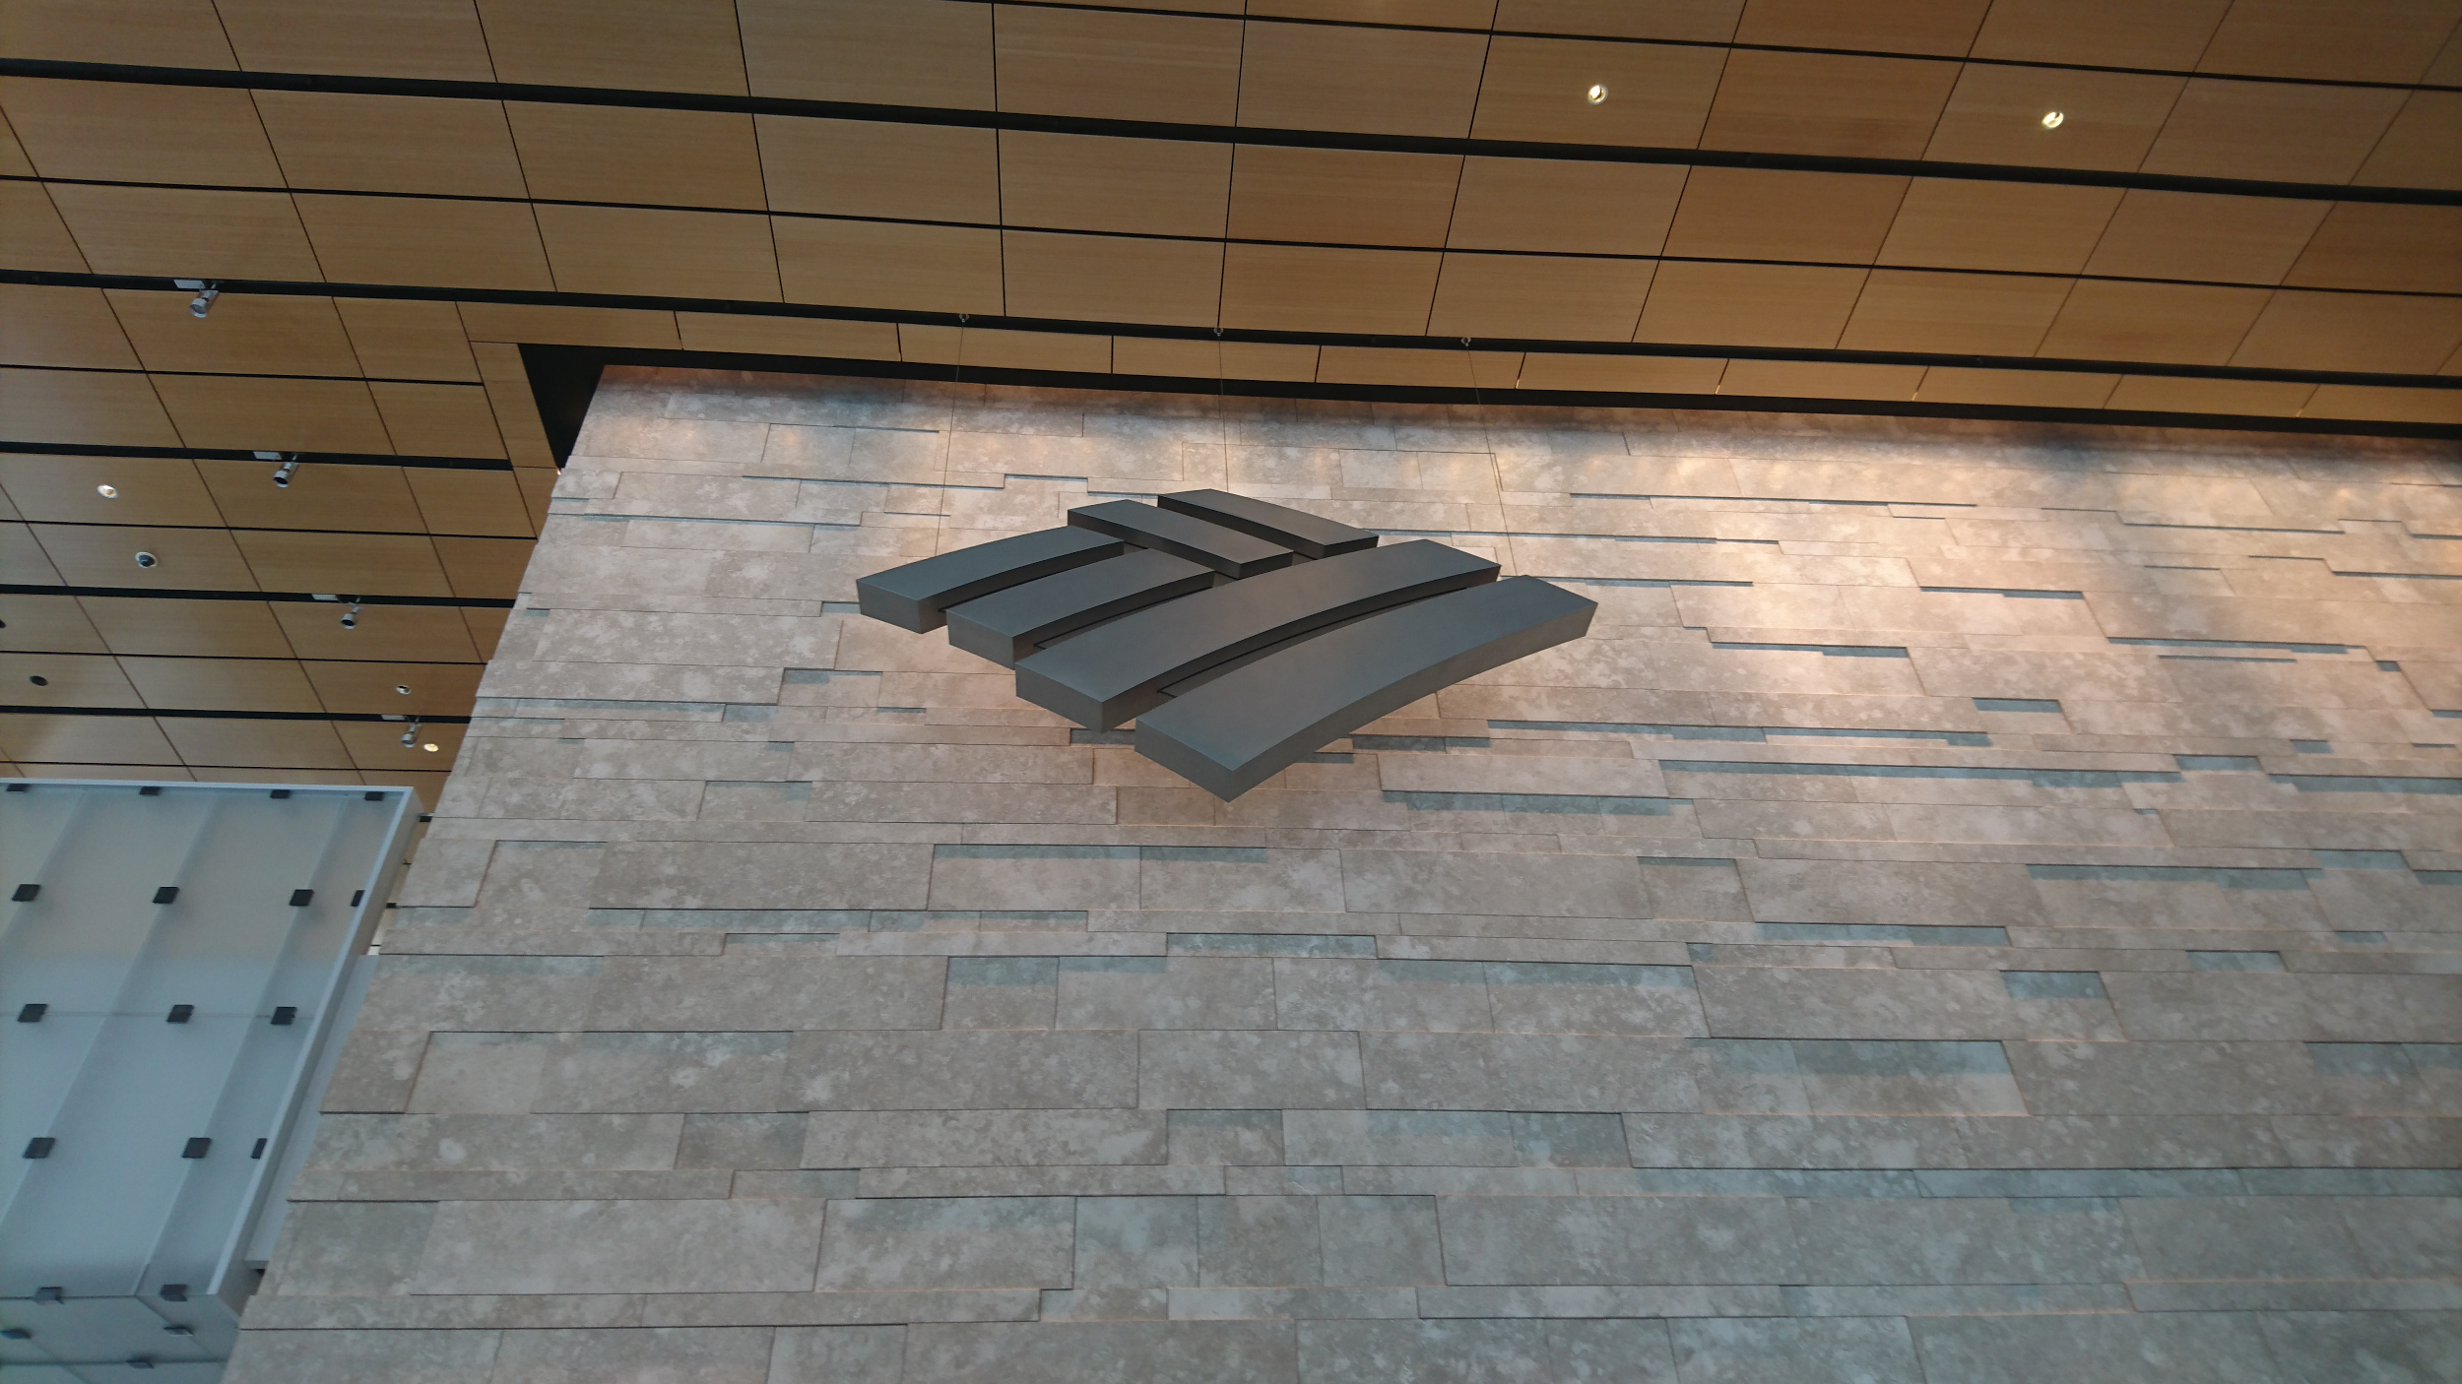
Bank of America Tower
The view from the tower

Slide 10
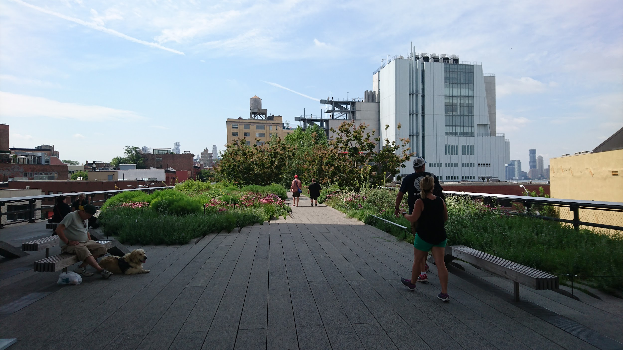
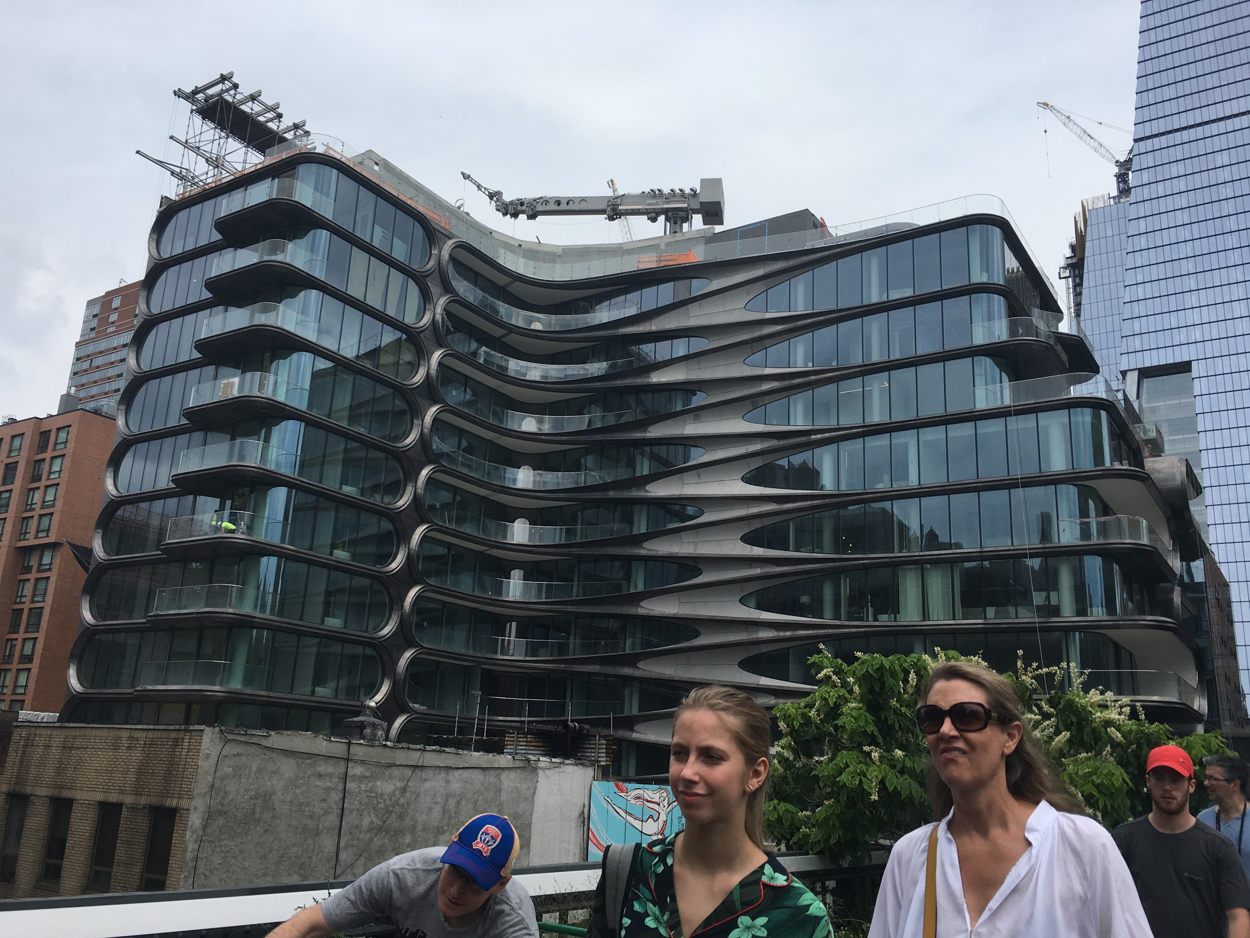
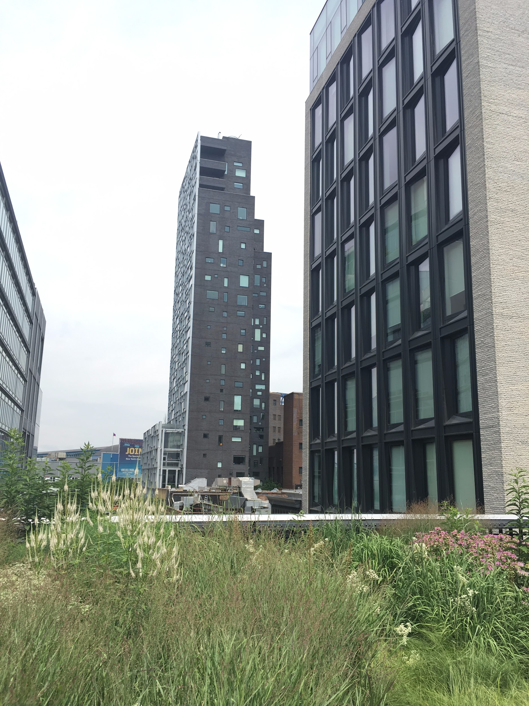
High Line

Slide 11
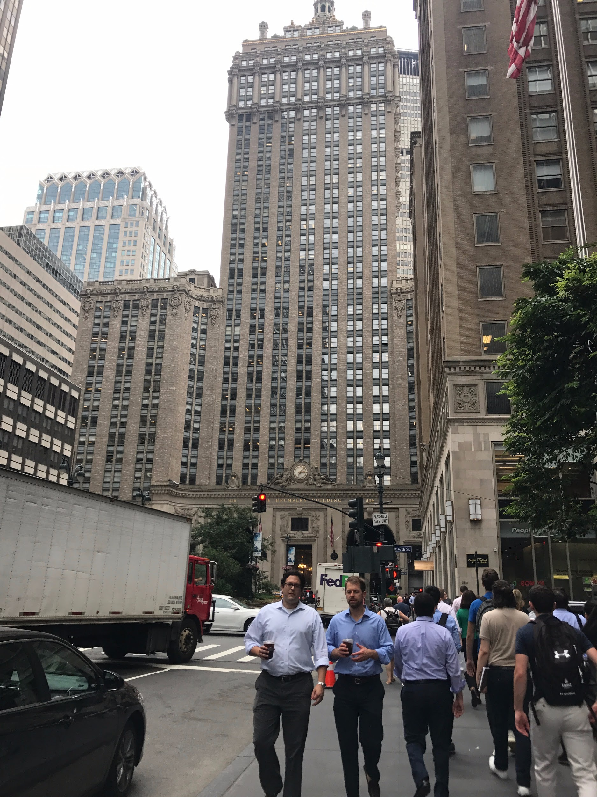
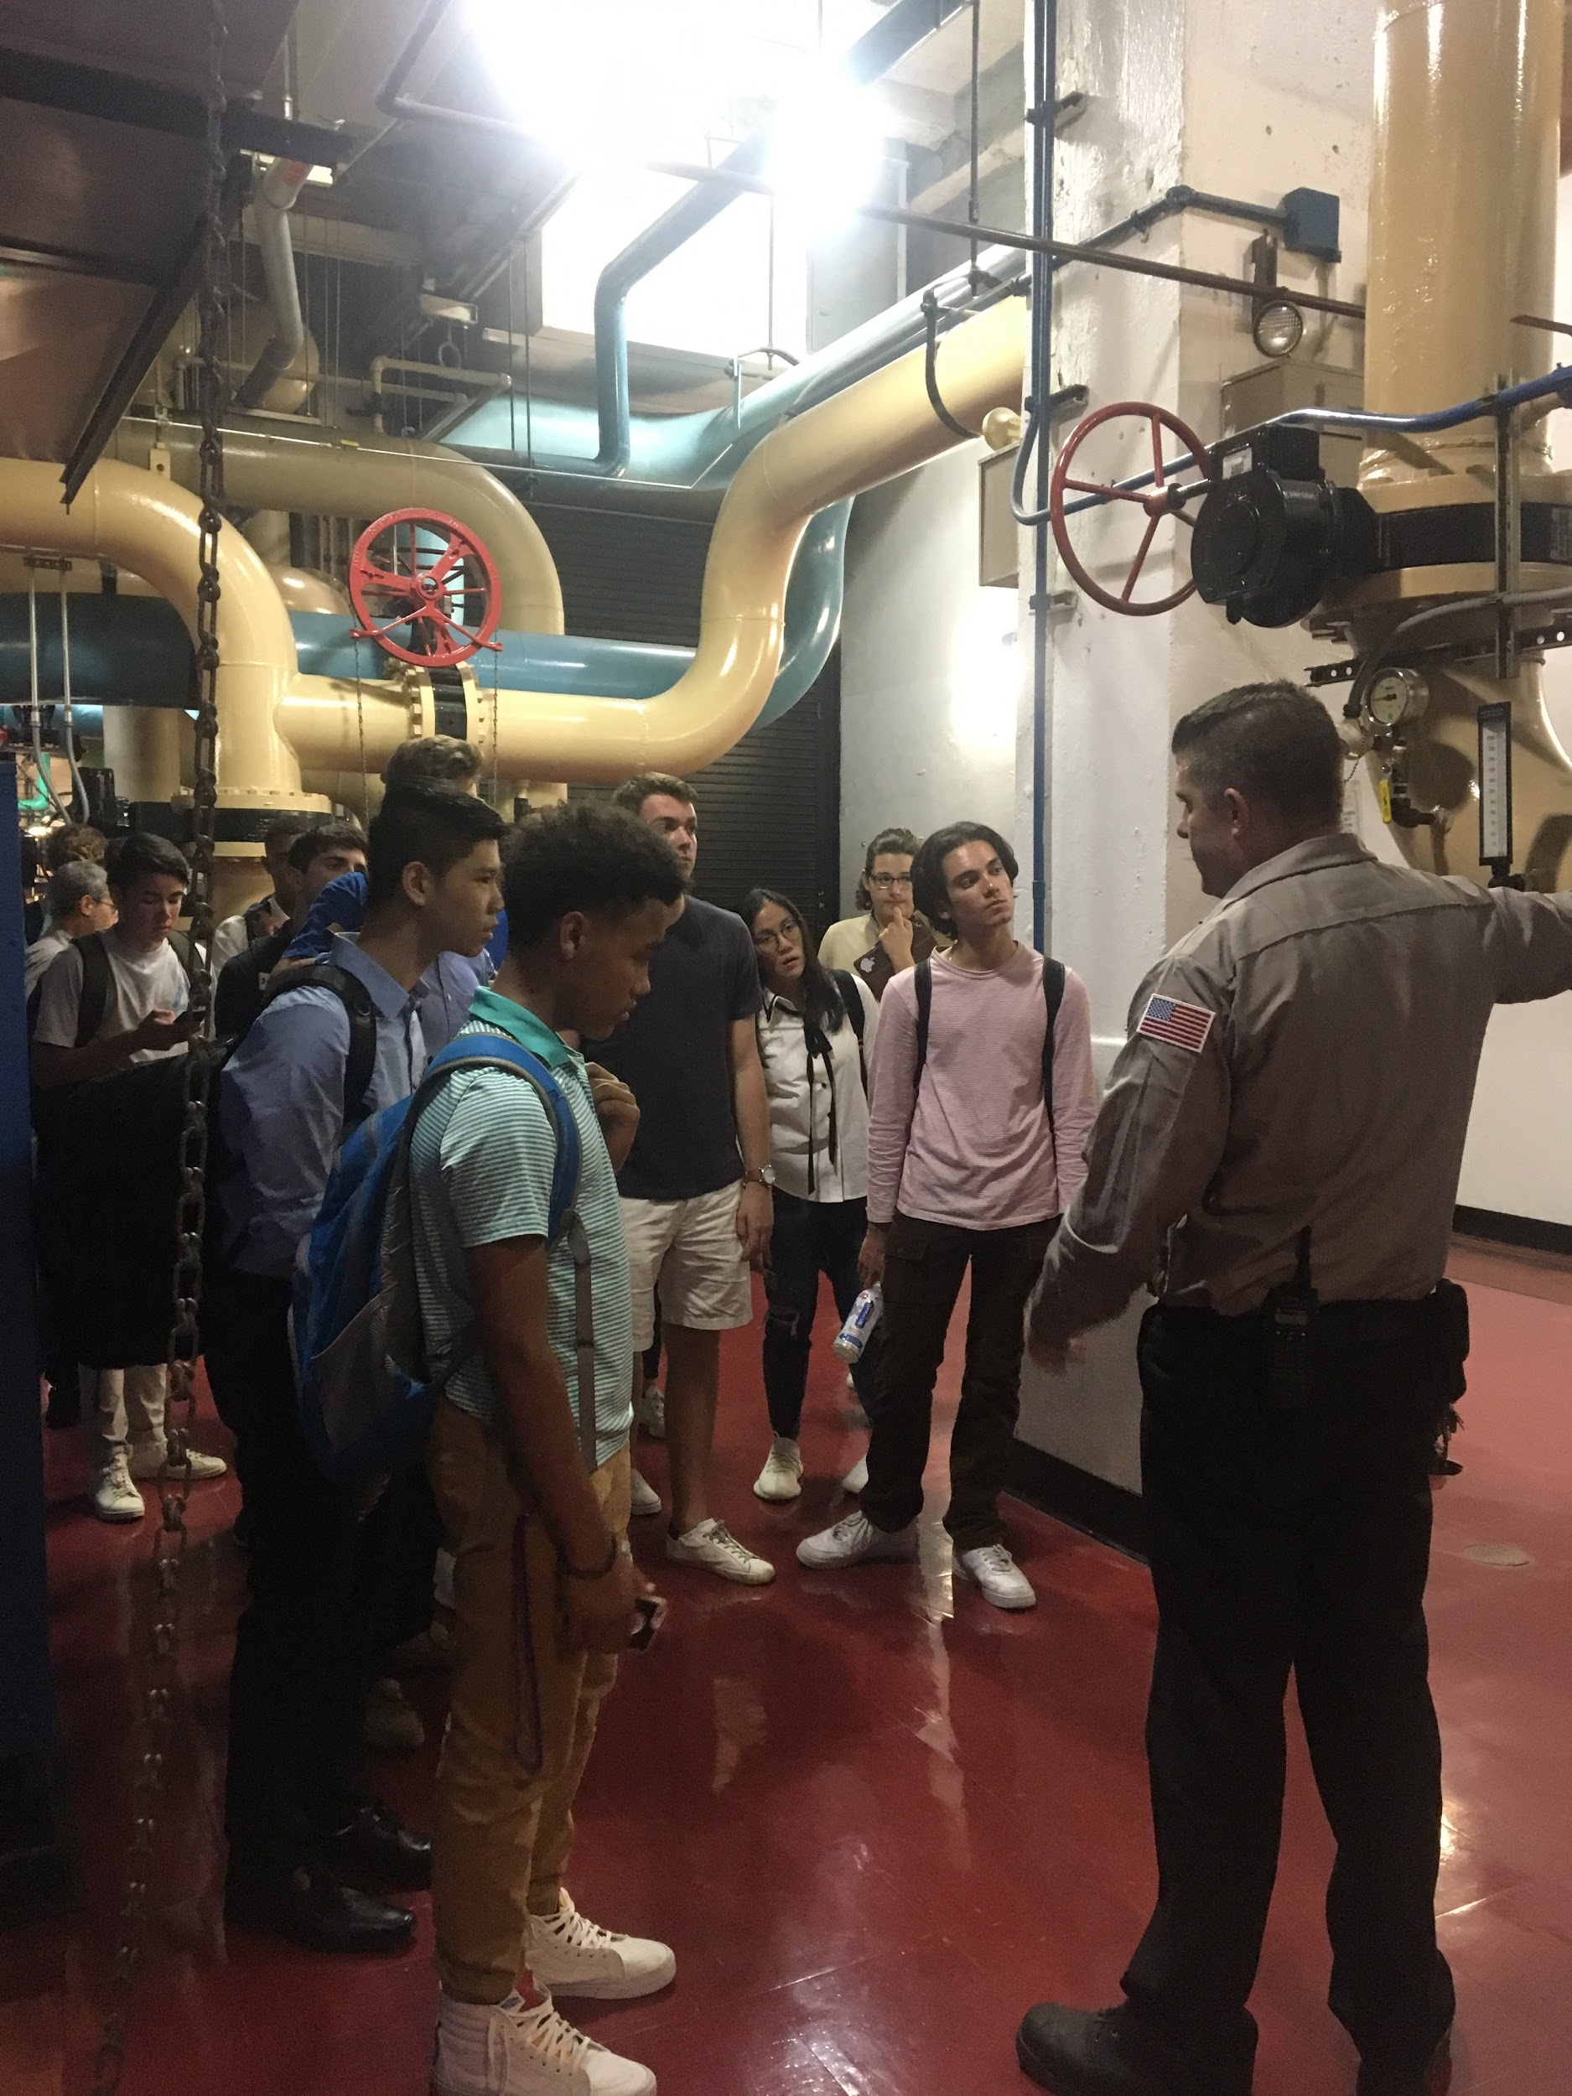
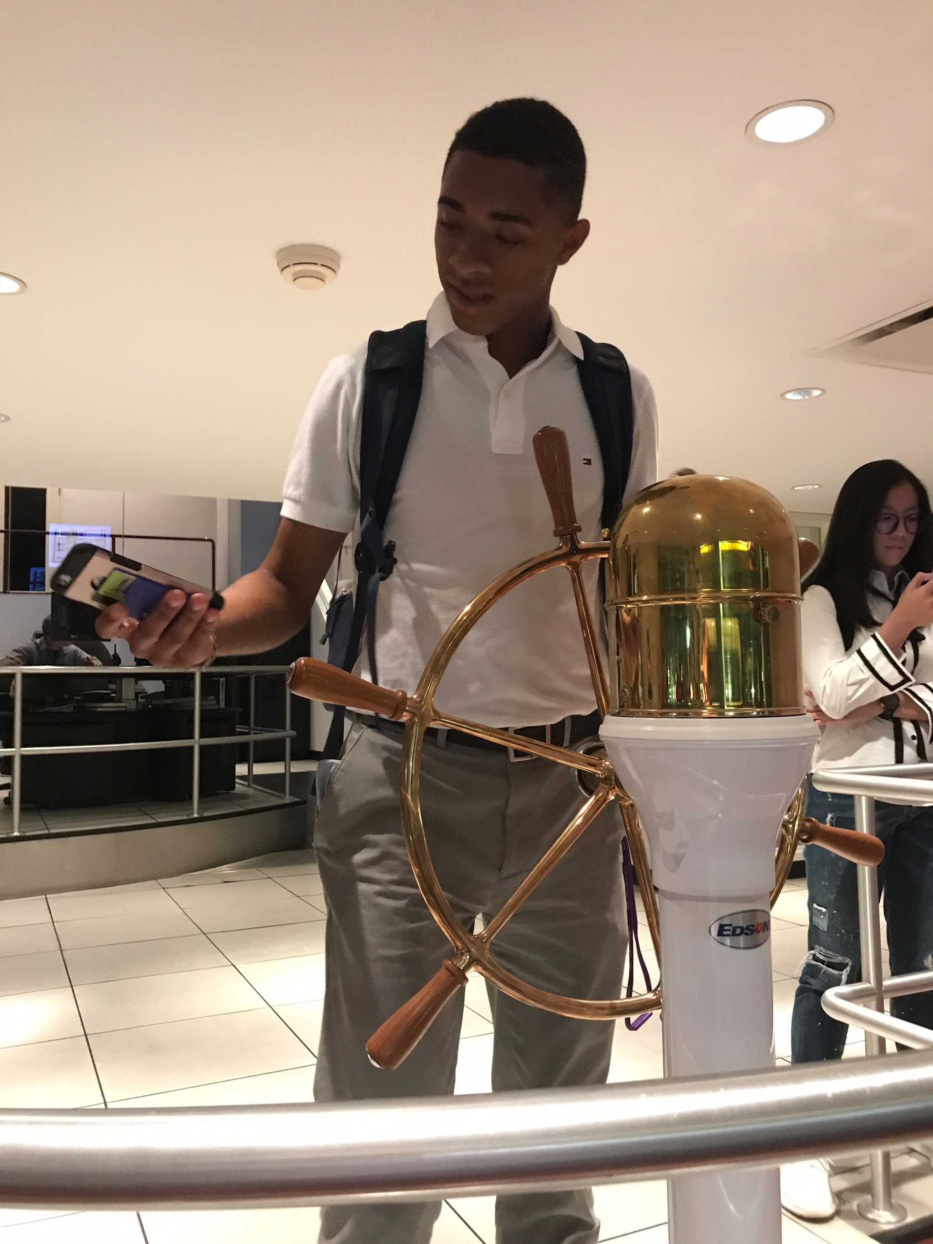
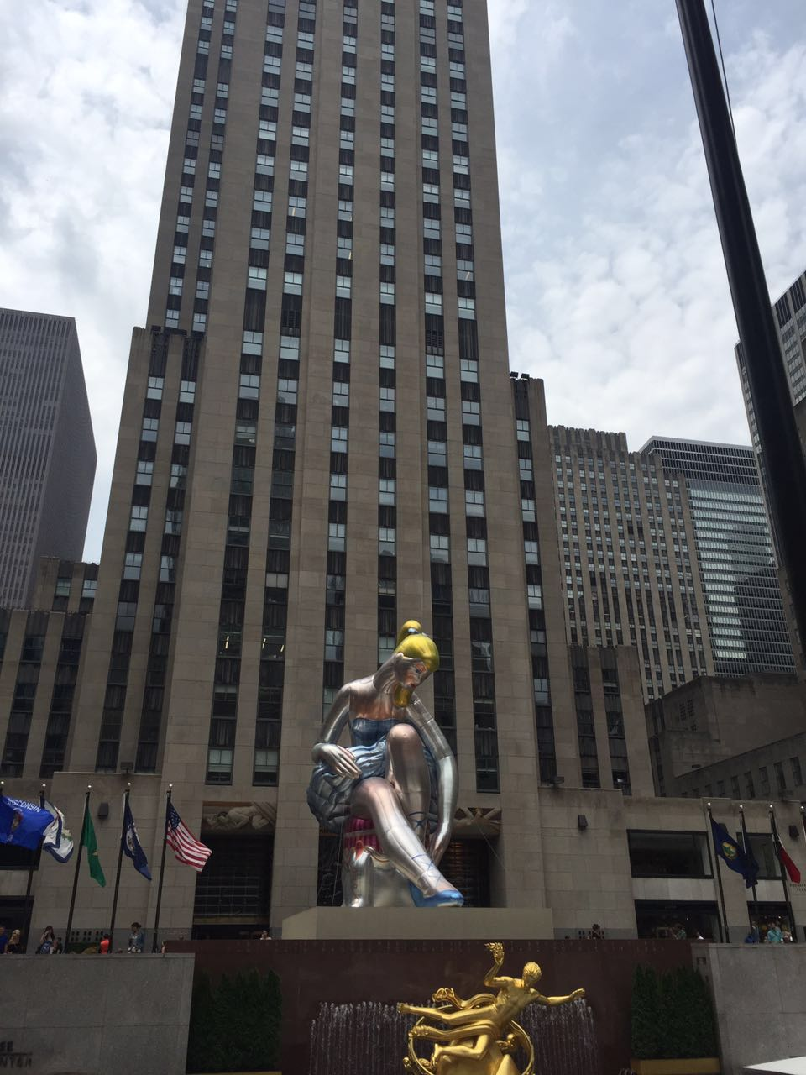
Rockefeller Center

Slide 12
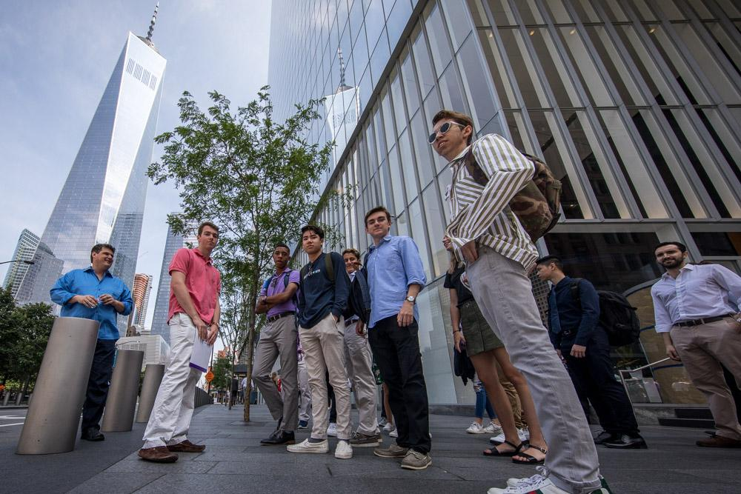
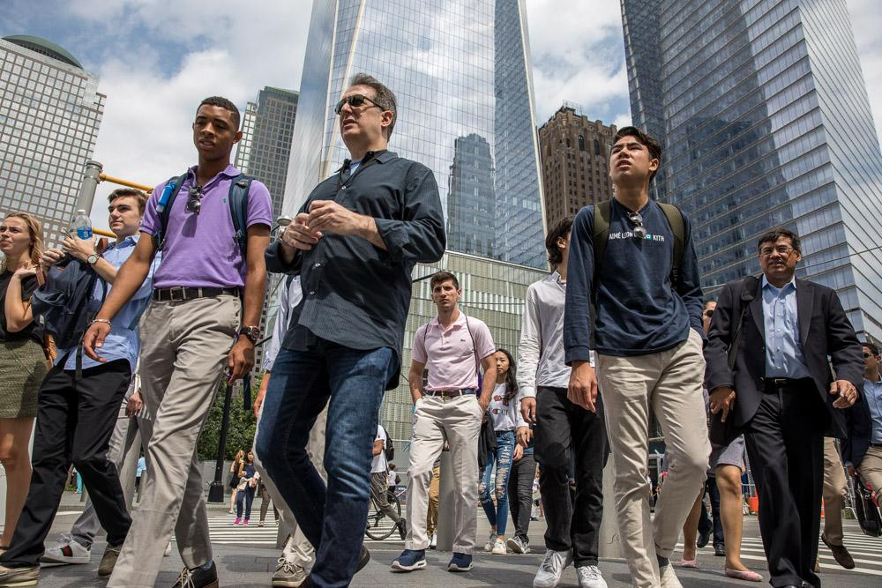
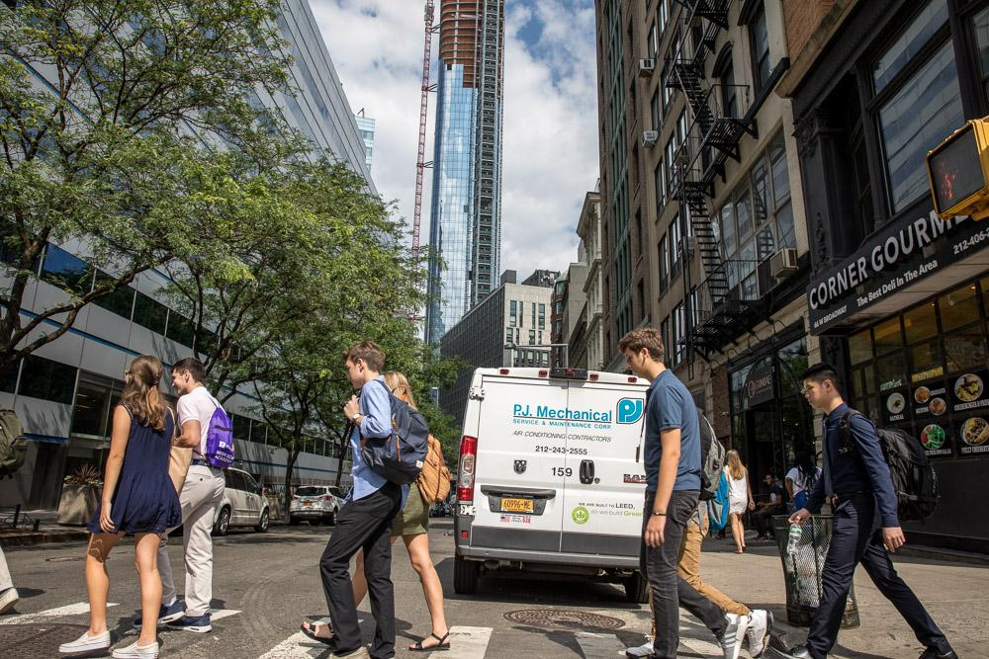
Fam Pics

Slide 13
Student Projects

Slide 14
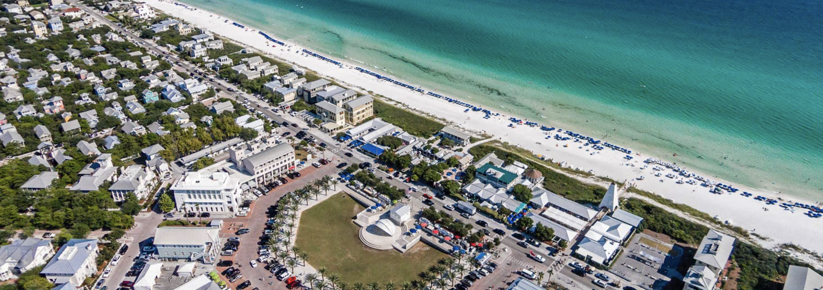
2215 E Co Highway,
Santa Rosa Beach, FL 32459

Slide 15
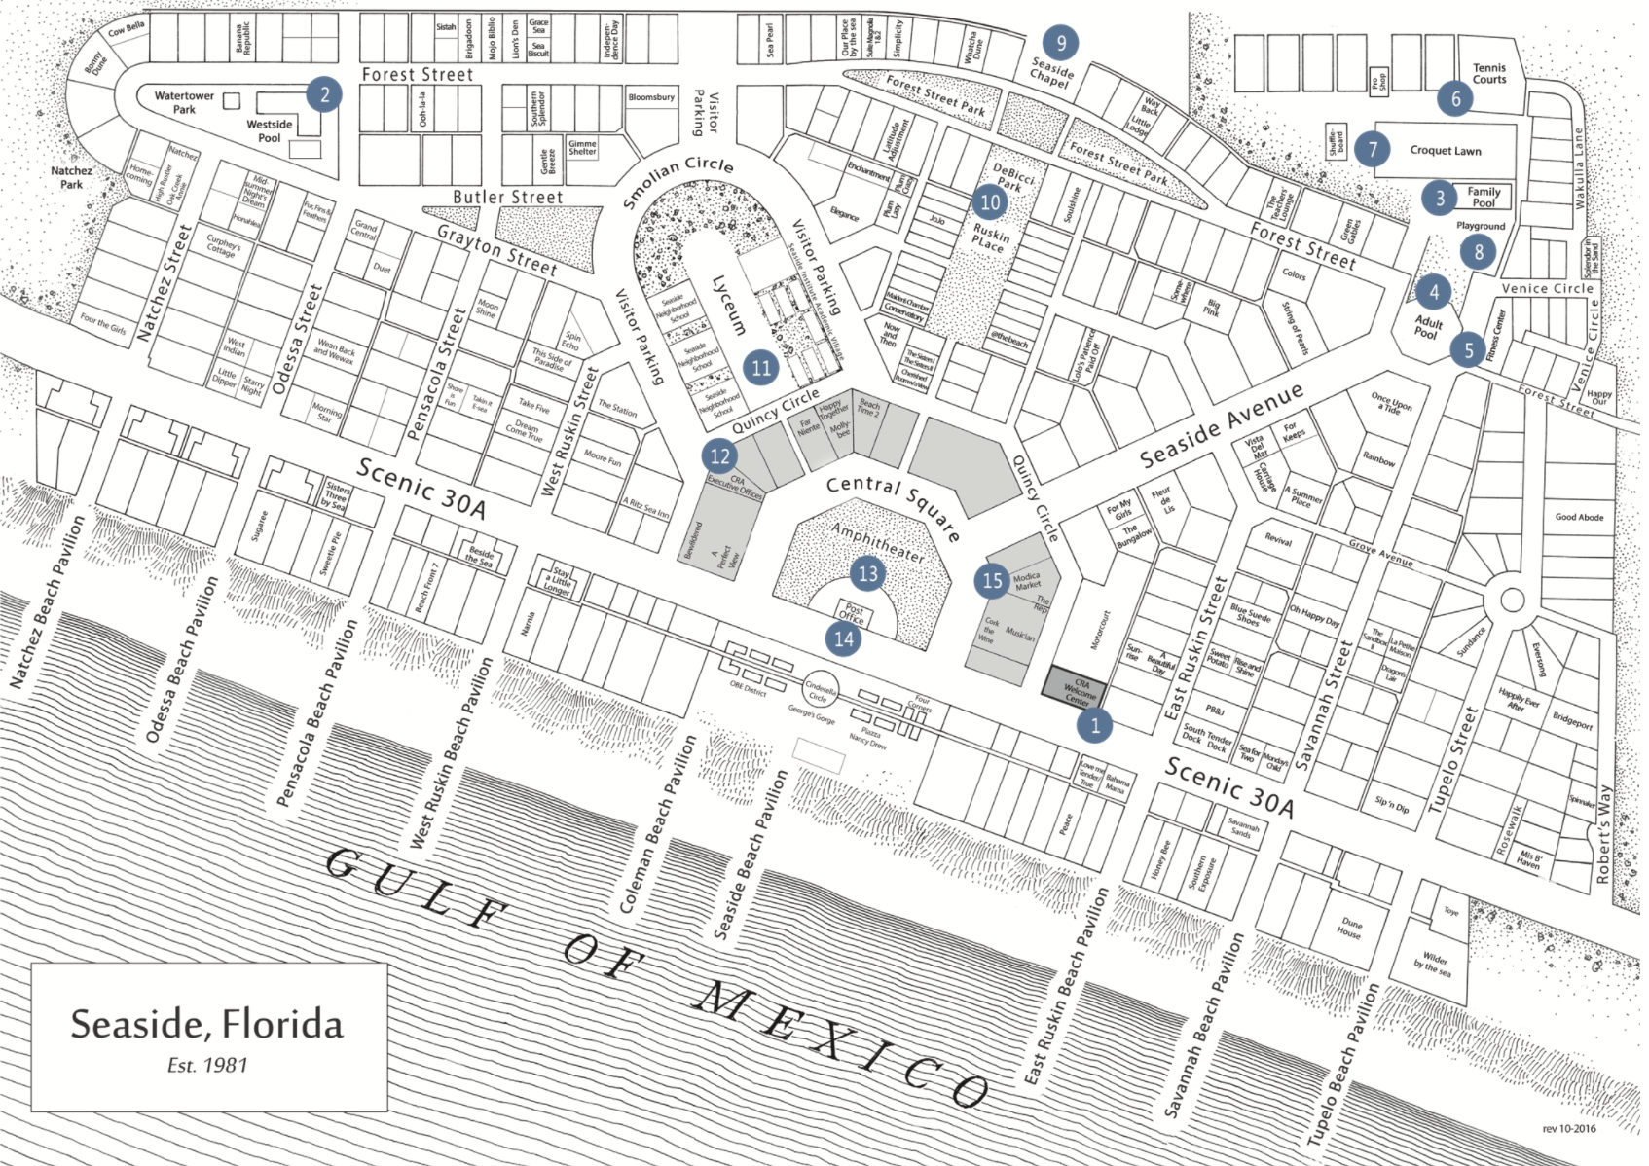
Seaside, Florida
Small resort, higher income community
Located in Northwest Florida on the coast of the Gulf of Mexico
Location is surrounded by residentials

Slide 16
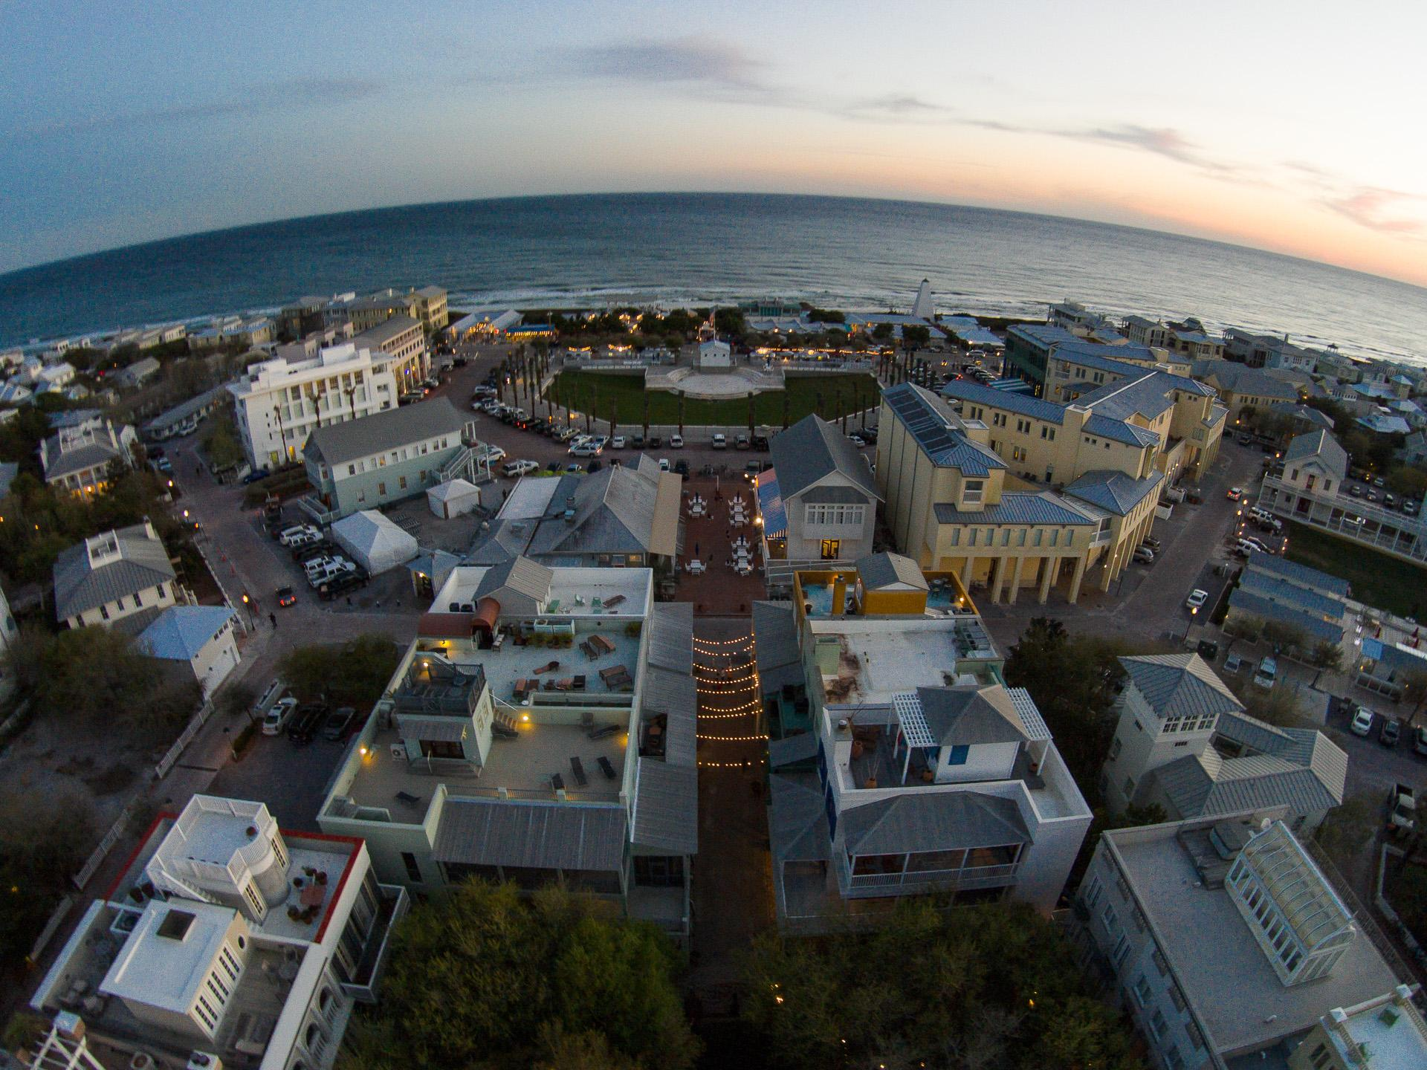
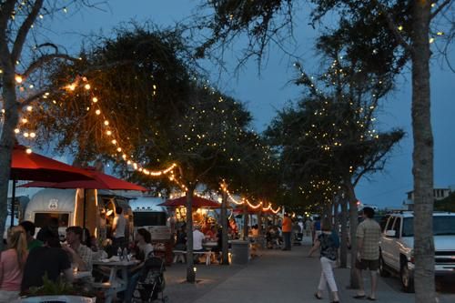
Stationary Food Stand
~Seaside, Florida~
Ryan, Grace, Jess

Slide 17
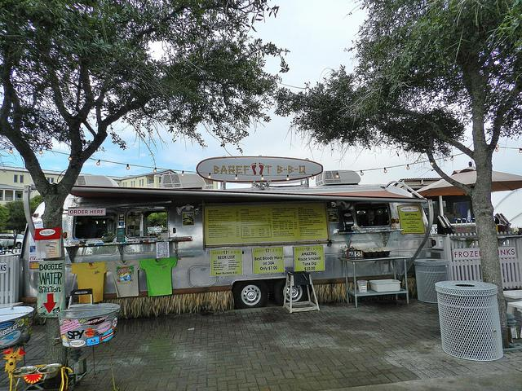
Why
Seaside, Fl is a rapidly-growing beach town in Western Florida whose combination of a young and wealthy crowd creates a suitable environment for local retail businesses and food vendors. After viewing the available eating options in this community, we decided that a cookie dough stand would provide the highest probability for success.

Slide 18
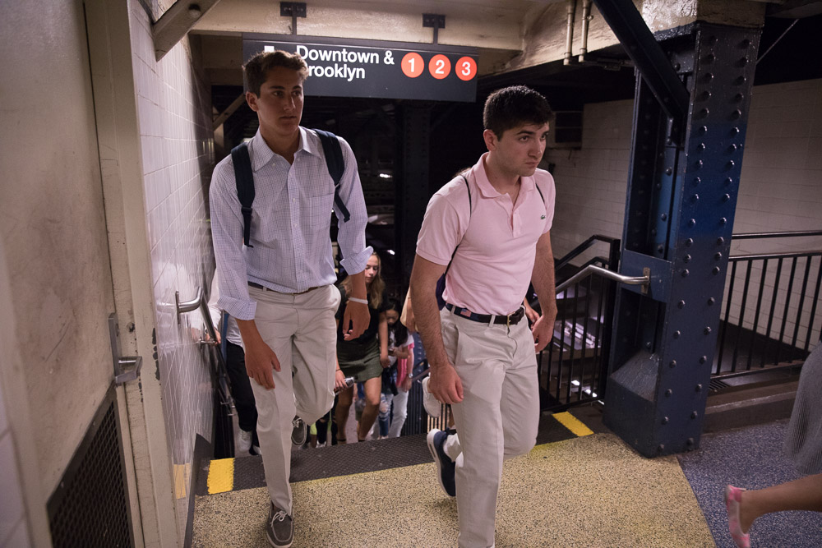
Group 2 Members Who Aren’t Here
Matt, Robert, Sean, Emre
VISIONAIRE
Emre
Matt and Rob

Slide 19
Income/Cash Flow Gas Station
Matt, Robert, Sean, Emre
Revenue: Projected Gross Income: Income from Gas Station %-age Rent: $0.013 x 1,352,000 (cars at gas station in a year) x 60% (cash) = 10,545.60 Income from Gas Rent: 20,000/month x 12 = $240,000 Income from Convenience Store: $5 x 1,352,000 x 10% = $338,000 Income from Kiosk: 7,000/year = $84,000 Total PGI: $672,545.60 Vacancy/Credit Risk: 10% of Projected Gross Income: $67,254.56 -------------------------------------------------------------------------------------------------------------------------------------------- Effective Gross Income: $605,291.04 OPEX (Accountant, Return, Reserve): 3% of Revenue: $20,176.37 --------------------------------------------------------------------------------------------------------------------------------------------Net Operating Income: $585,114,67 Capitalization Rate: 19.5%

Slide 20
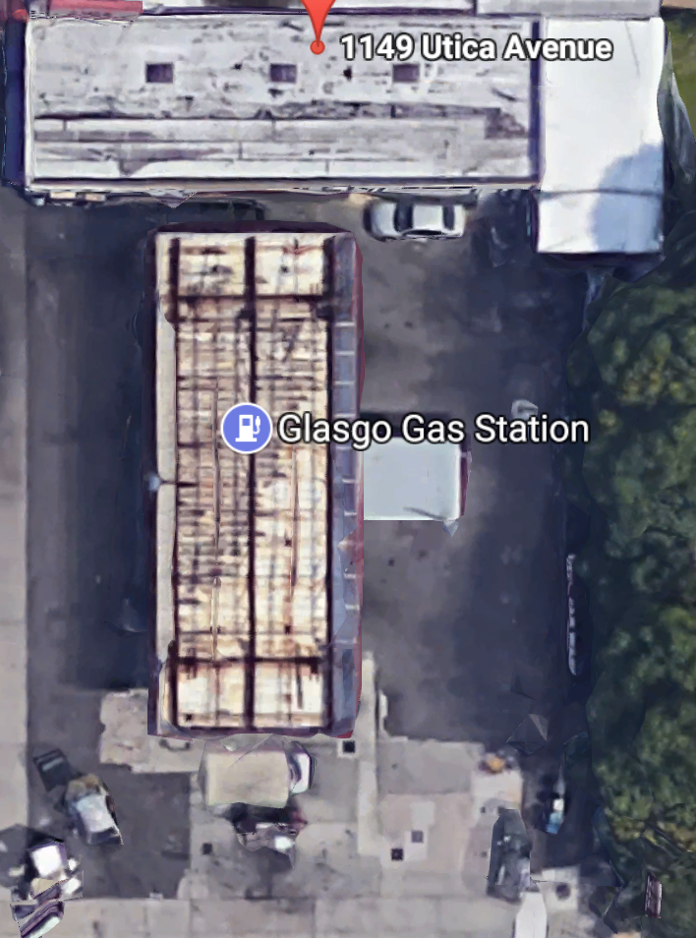
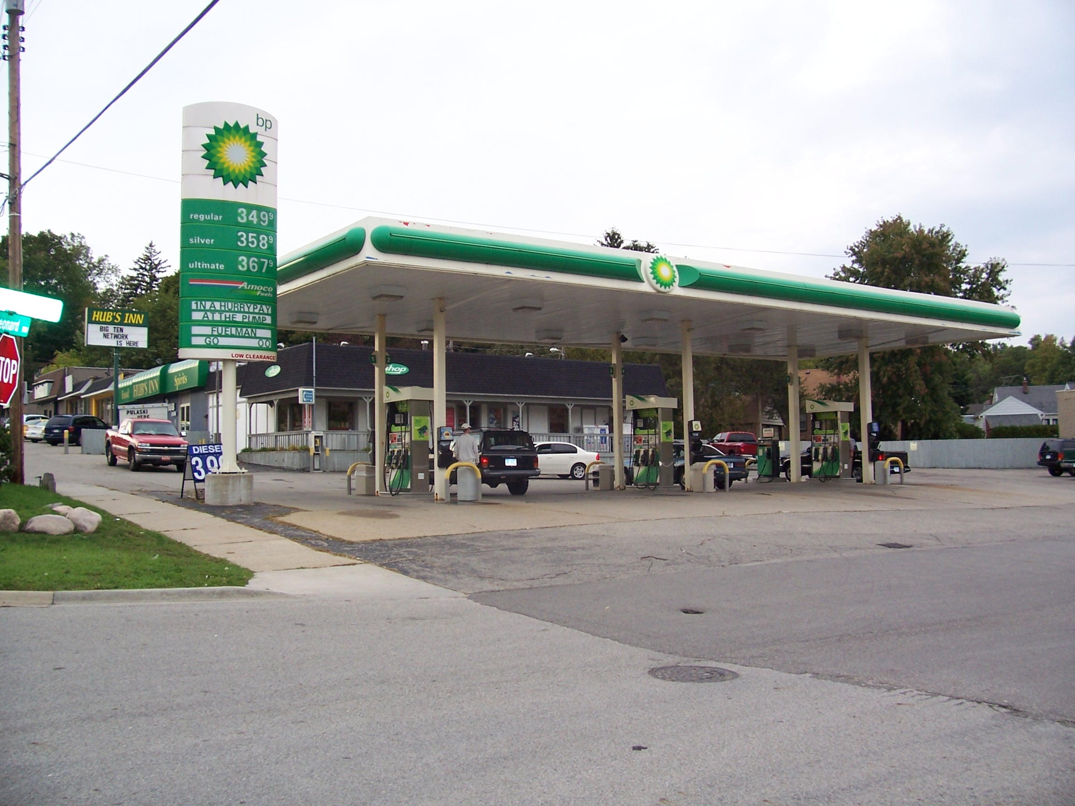
Gas Station on 1149 Utica Ave, Brooklyn, NY
Matt, Robert, Sean, Emre
Property Value: 1 million
Buying Price: 2 million
Soft Costs: $100k (plans, permits, engineers, architects, lawyers)
Hard Costs: $900k (to build convenient store and renovate carwash with dunkin donut franchise)
Total Costs: 3 million

Slide 21
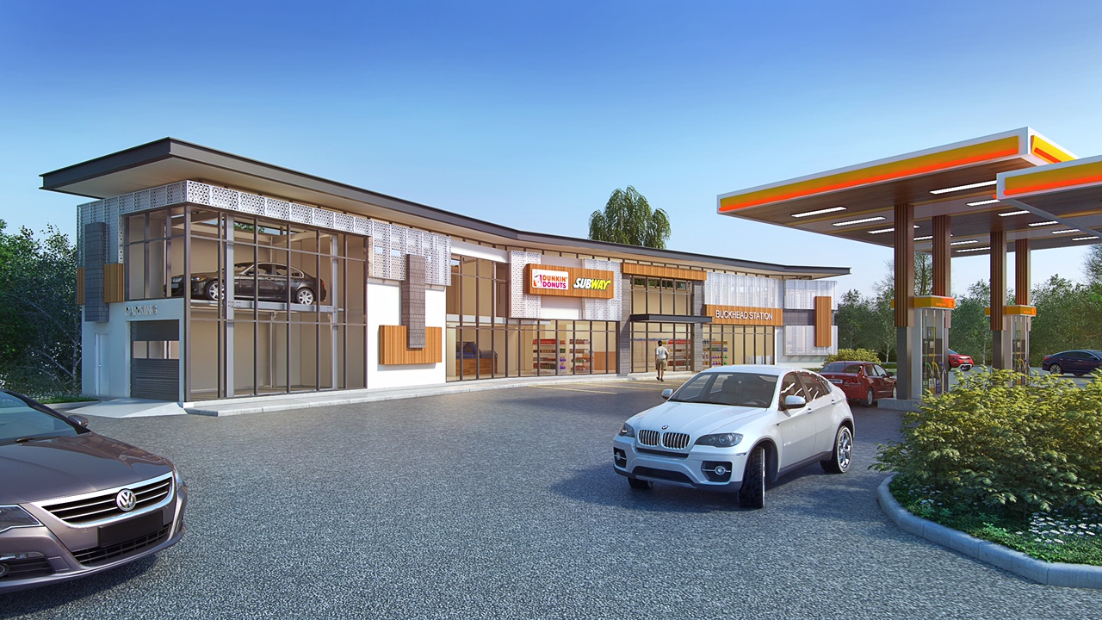
Why We Chose This Location
Matt, Robert, Sean, Emre
Property values in Manhattan are rising, which have caused many gas stations to move out of the area.
7/11 is right across the street from this property.
High amounts of traffic
Convenience store at the gas station

Slide 22
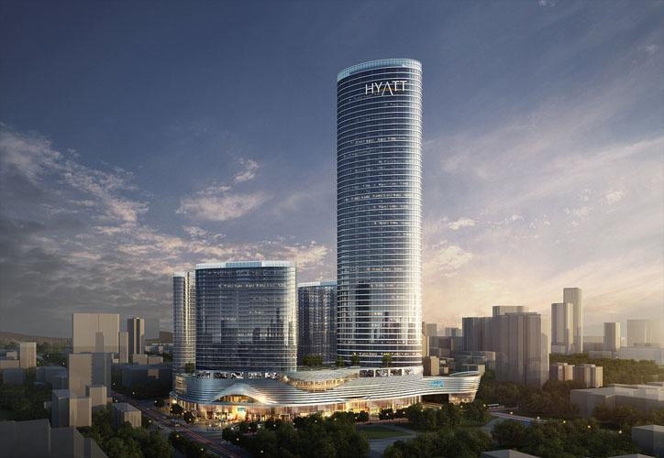
Versailles Center : 20 Liberty Street
Versailles Center is a state-of-the-art Commercial Center located in Downtown Manhattan in the Financial District
The building is a composition complex which includes a shopping center located on the podium of the towers with large hallways connecting the shops creating an easy flow of people.

Slide 23
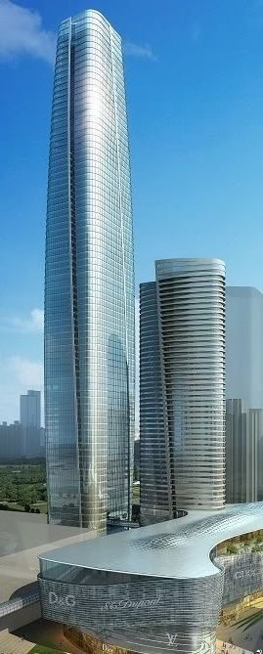
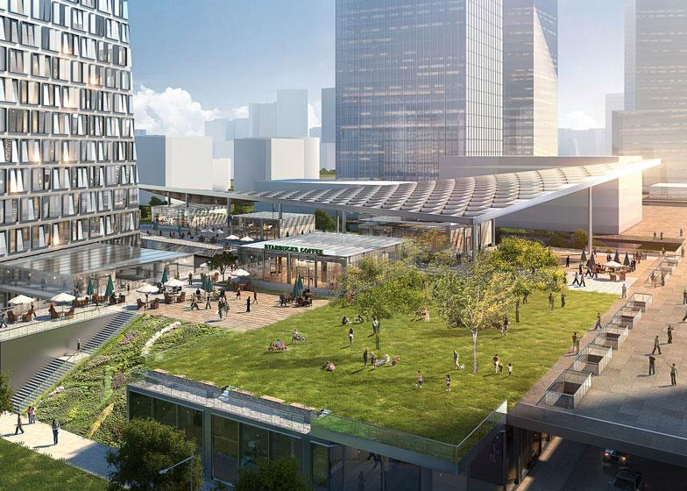
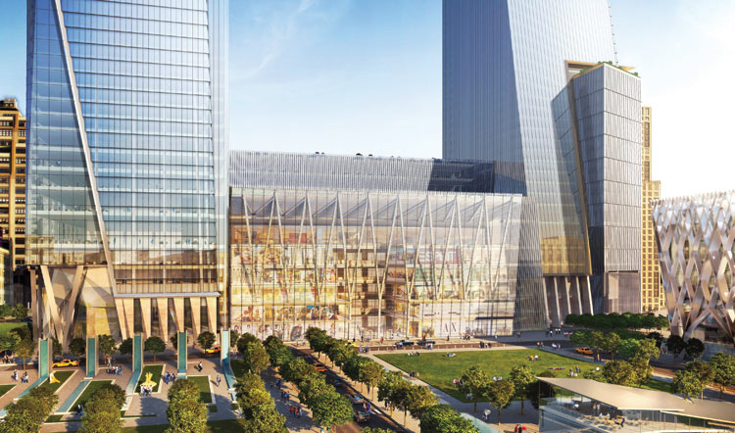
The Center also includes two towers that will be used for commercial use. The tallest tower, Prism One, will be over 100 stories high and will include helipads and an observation deck for our guest to enjoy the view
The podium will also include a park area on the door of the building and abundant parking space and even a library for people to enjoy

Slide 24
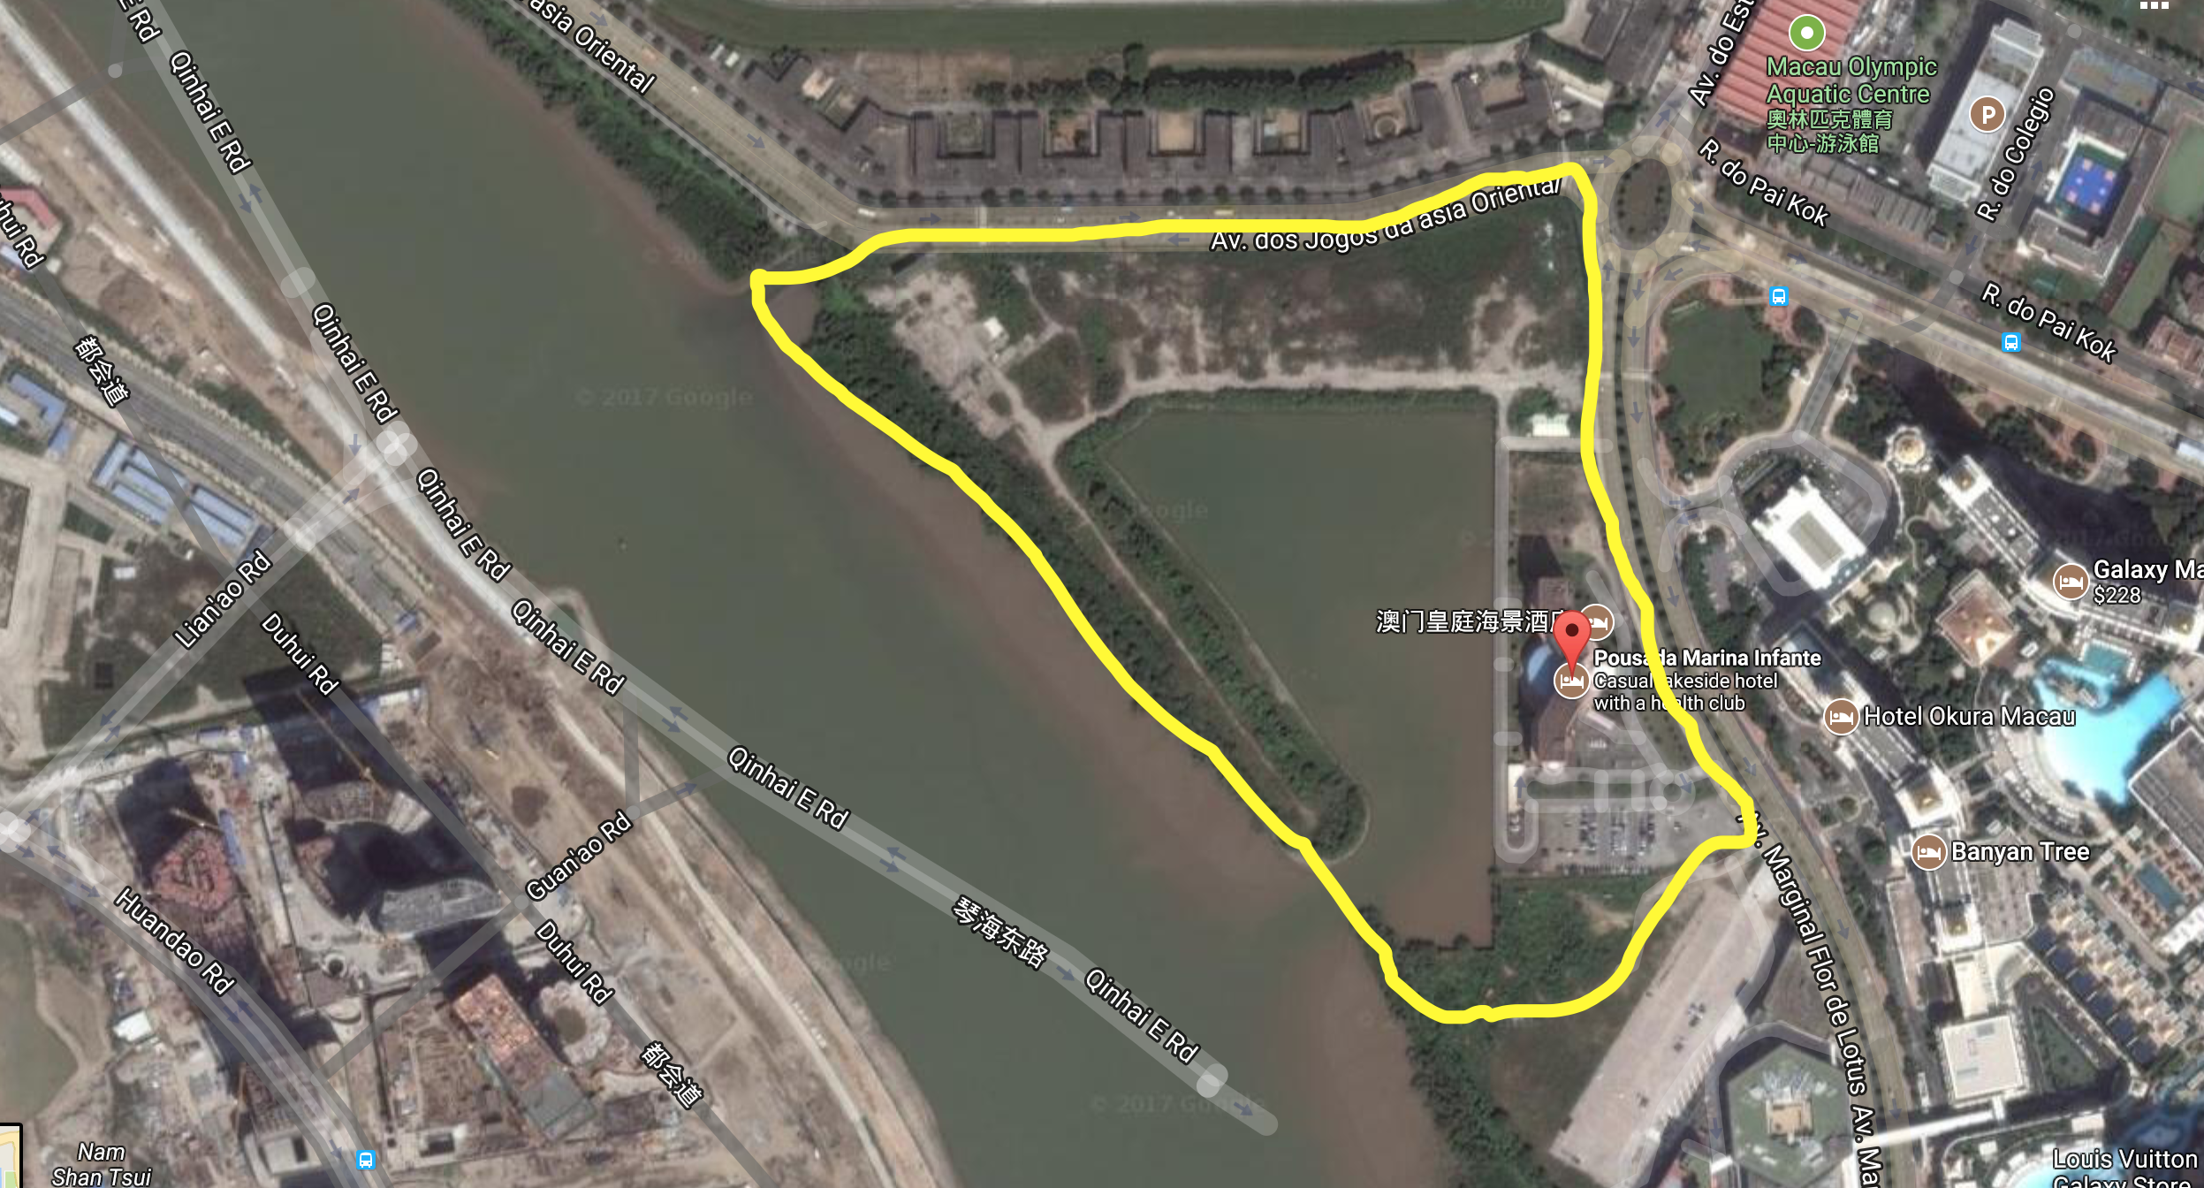
Residential Apartments
Maggie, Alice
Address: Avenida Marginal Flor de Lótus, Taipa, Macau

Slide 25
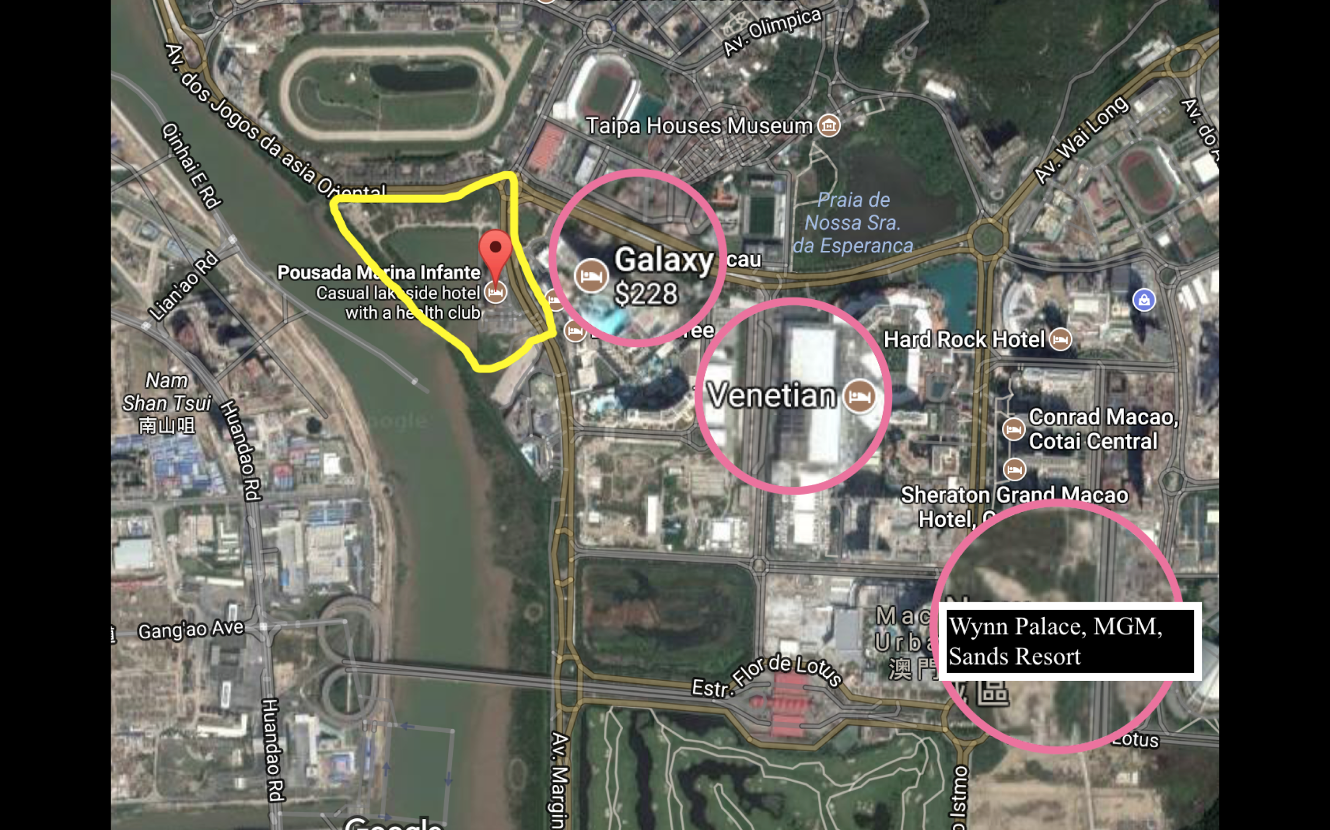

Slide 26
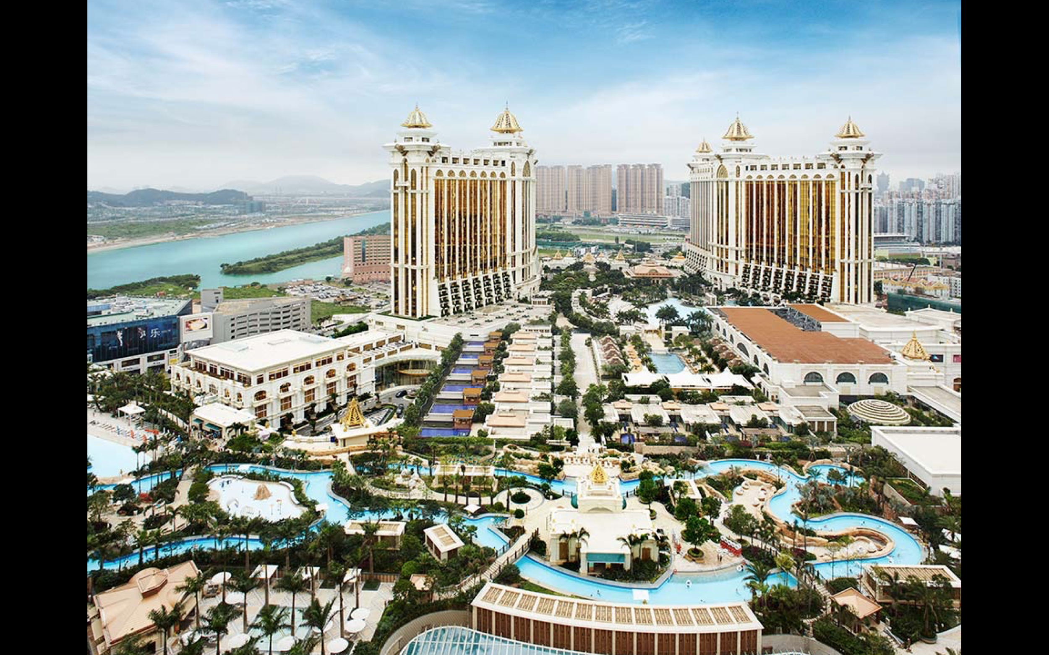

Slide 27
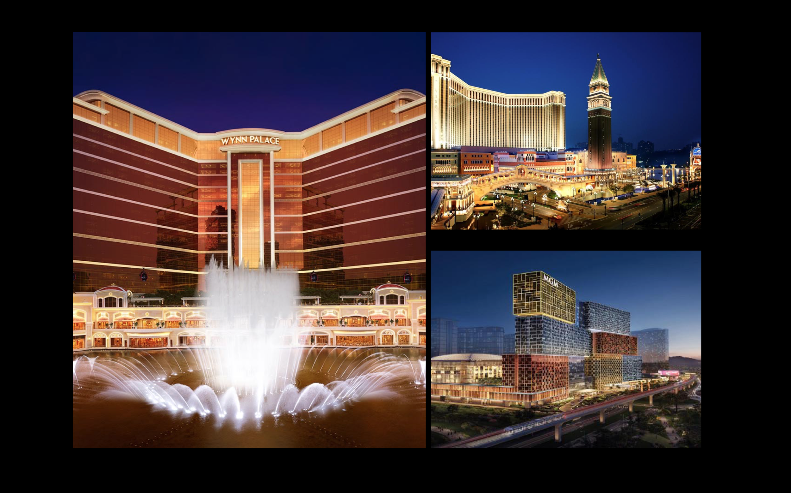

Slide 28
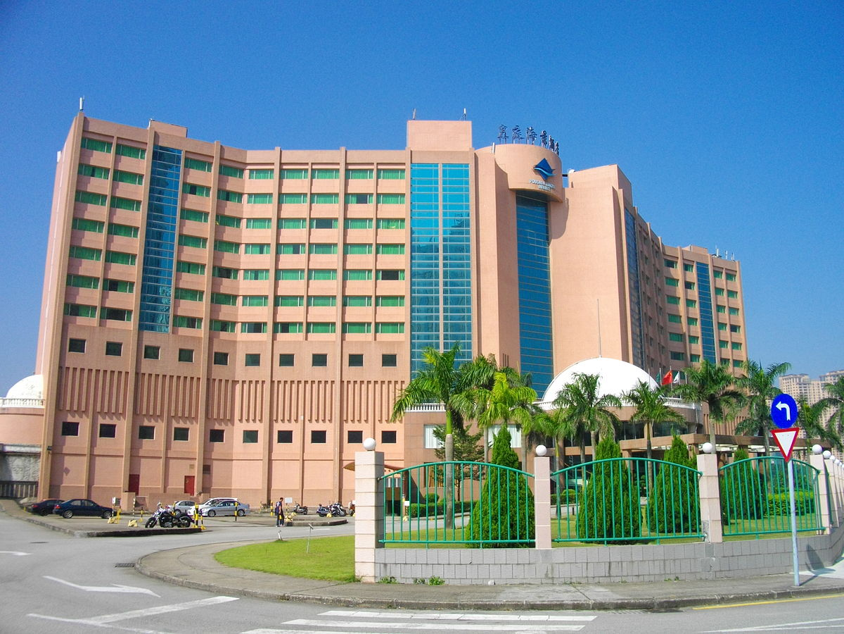
Maggie, Alice
Land Area: 400,000 Sq Ft.
Property Value: $1.5 Billion ($3750/Sq Ft.)
Zoning Floor Area: 3,500,000 Sq Ft.
FAR: 0.1143
Construction Costs: $400/Sq Ft. ($1.4 billion)
Total Cost: Approx. $3 billion
Total Income After Tax: Approx. $4.5 billion ($1750/Sq Ft.)
Net Income: $1.5 billion
ROI: 0.5
Gross Margin: 33.33％

Slide 29
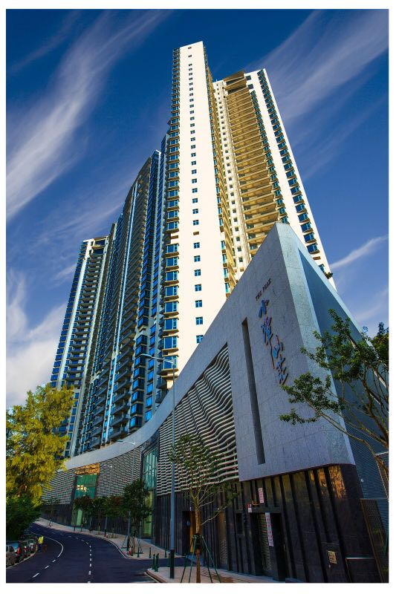
y?
Why?
Great Opportunity for Residential Apartments:
Next to newly developed community
Close to bridge that connects Taipa to Macau Island
Access to public transportation
Airport and Cotai Ferry Terminal
Casinos and shopping malls
Multiple schools nearby: University of Macau, public and private schools
Walking distance from restaurants and supermarkets

Slide 30
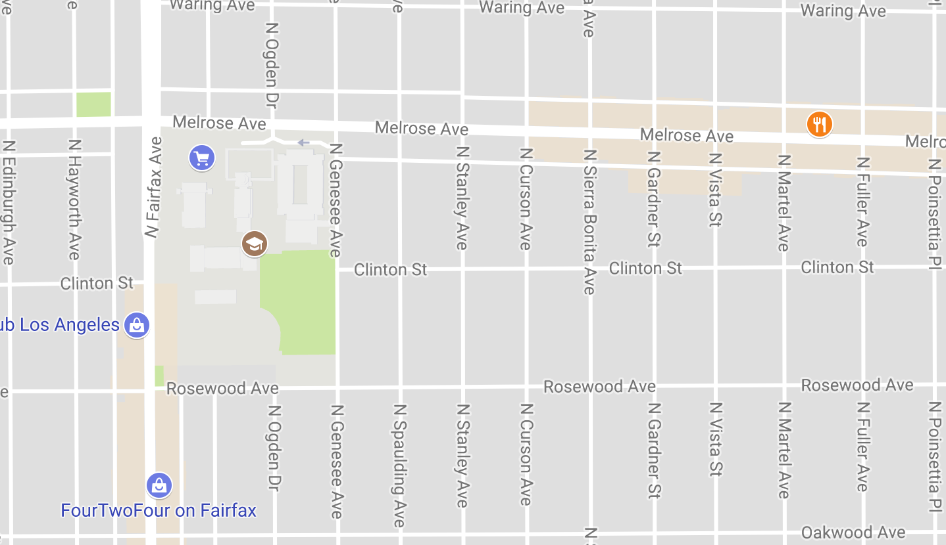
Location
Jeremy, Myles, Dennis
An available lot or pre existing building on either Fairfax Avenue or Melrose in map area. This area is consistently crowded because of events and anchor stores. Trendy restaurants tend to be profitable in this area.

Slide 31
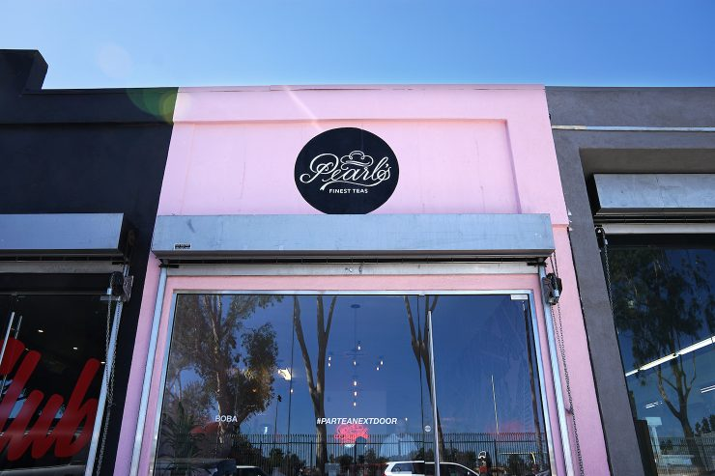
Tenant
The tenant would have to be a small restaurant or food establishment. There is 3,000 square feet of space available to operate a business with a small kitchen.

Slide 32
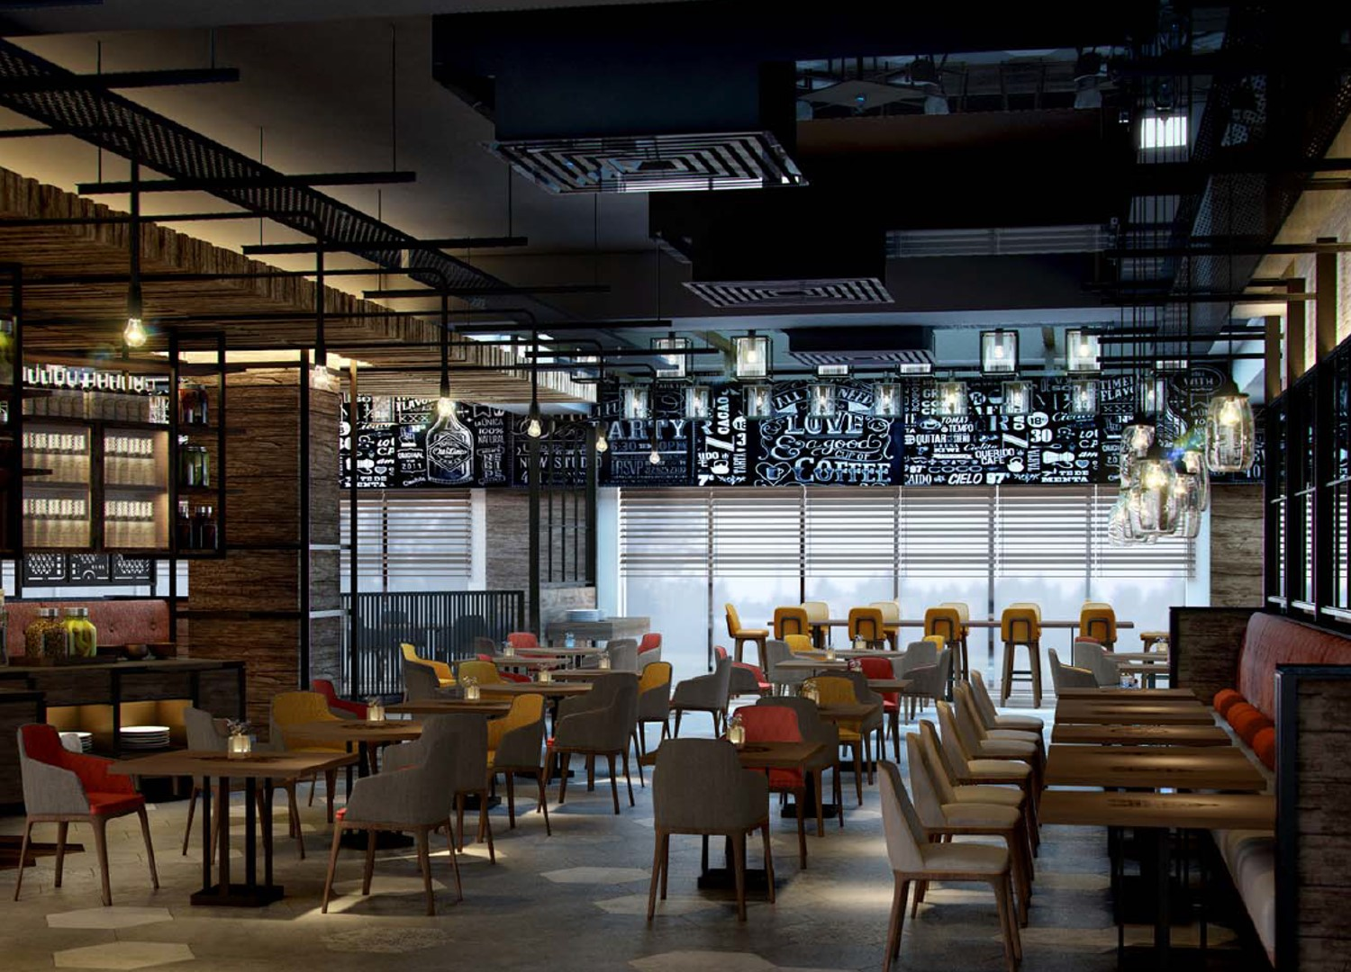
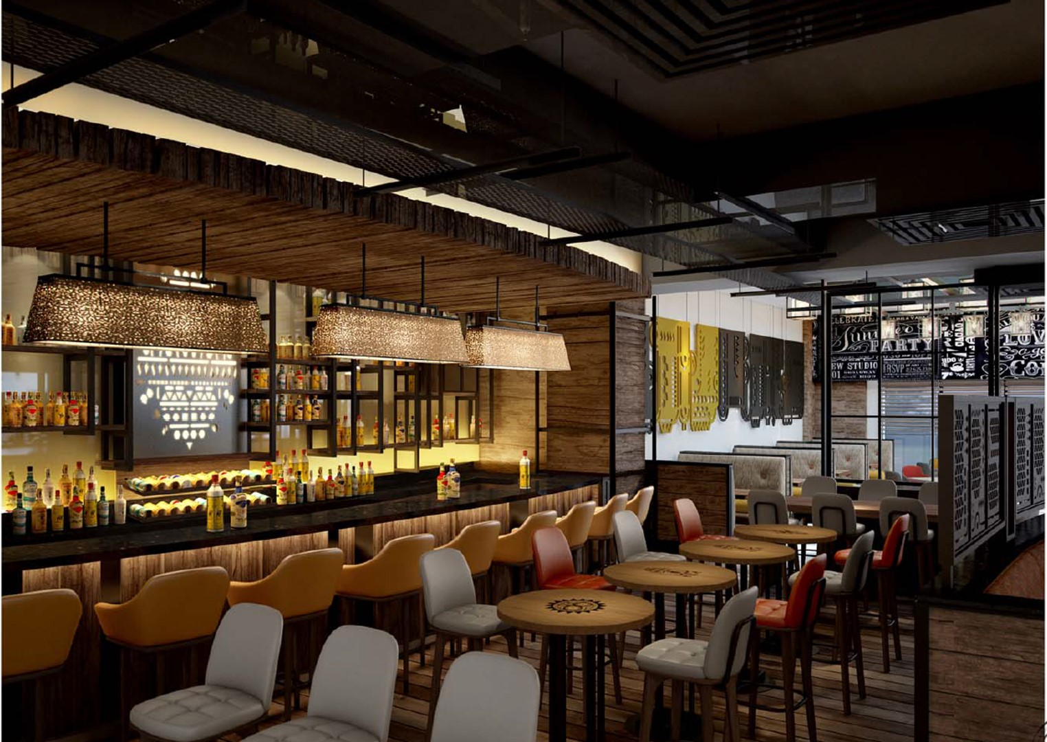
Property
The lot value would $750,000. The building would have to be built at $110 per square foot. For the building to be built, the property and hard costs would total $1,200,000. Typically rent on this street would run around $110 per square foot per year resulting in approximately $330,000 gross income.

Slide 33
Other Expenses
Building Cost
$750,000
Hard Cost
$450,000
Soft Cost
$45,000
Marketing
$100,000
TPC
$1,345,000
Gross Income
$330,000.00
Payment: $102,713.40
Expenses: $9,900.00
NOI: $217,386.60
Sale Price at 8% CAP Rate = $2,717,332.50

Slide 34
Thank You!

